Slide 1
Final Presentation Group E
Isokpehi Faith, Sathiyamoorthi Shanmugapriya, Tunde Derrick
700.865/866 Basic Lab: Robot Design
18th June 2025

Slide 2
REPORTING AND GROUP OVERVIEW GROUP MEMBERS: 3
Isokpehi Faith: Documentation, Technical Reporting, Component Specification and calculations.
Sathiyamoorthi Shanmugapriya: PCB Design.
Tunde Derrick: CAD Design.

Slide 3
Tools Used:
Autodesk Fusion 360 for mechanical design.
KiCad 9 for PCB development.
PowerPoint and MS Excel for documentation and reporting.

Slide 4
Isokpehi Faith Task Description & Specifications

Slide 5
Robot Requirements and Specifications (set 5)
Main Specs | Details | Achieved
Robot Weight | 4000gr | 3962g
Nominal Speed | 400mm/s | 400 mm/s
Cost of materials and components | Max. 1200€ (assume that an inhouse 3D printer is available) | 886.64€
Footprint shape | Rectangular | Yes
Footprint size | 50-60cm | Yes
Obstacles
Climb stairs | 3.5cm height | Yes
Cross gaps | 14 cm | Yes
PCB specs | To be Clarified- keep a box of 20x25x10cm^3
TASKS
Min. Runtime | 25min | (26.4 min achieved)
Minimum clearance to walls | 10cm (omnidirectional) | Yes
Line-tracking capability | yes | Yes
Give acoustic feedback | 85 dB | Yes

Slide 6
General Considerations
The mobile robot was designed considering cost, performance, and task requirements. The frame base serves as the structural platform to which all components (motors, wheels, battery, sensors, PCBs) are attached. This frame was designed to be lightweight and rigid using in-house 3D printing for the body and aluminum rods for strength.
Four omnidirectional wheels were chosen for their maneuverability in all directions, which is crucial for line tracking and maintaining a minimum clearance to walls in a constrained environment. These wheels also aid in stair climbing and gap crossing by improving grip and directional control.
The selected motors provide sufficient torque to overcome the 3.5 cm stair height and to cross 14 cm wide gaps. Calculations were made to ensure motor RPM and torque meet speed (400 mm/s) and weight (under 4000 g) requirements.
The ultrasonic sensors (HC-SR04) are placed on all four sides to measure distance from obstacles and maintain a 10 cm clearance from walls.
All components, including a custom PCB designed in KiCad, were selected to stay within the EUR1200 budget while ensuring good performance.

Slide 7
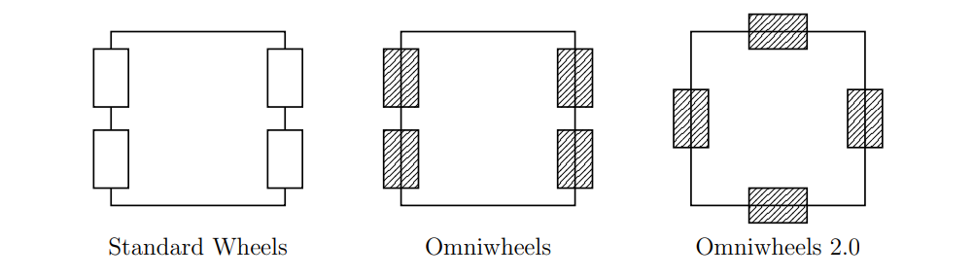
General Considerations of the robot shape(wheels)
Three frame designs were considered: standard wheel configuration, omnidirectional (omniwheel), and a more compact omnidirectional 2.0 arrangement.
Standard wheels were inexpensive and lightweight but offered limited mobility which conflicted with the omnidirectional movement requirement.
Omniwheels provided full directional control, easy turning, and better control during navigation tasks like line following and obstacle avoidance. Though slightly heavier and costlier, they ensured performance reliability.
Omniwheels 2.0 provided a tighter structure but presented challenges in stair climbing and obstacle clearance.
The final design adopted a rectangular layout with four 100 mm omniwheels placed at the corners to balance stability, mobility, and clearance, optimized for climbing and gap traversal tasks as well as indoor line tracking

Slide 8
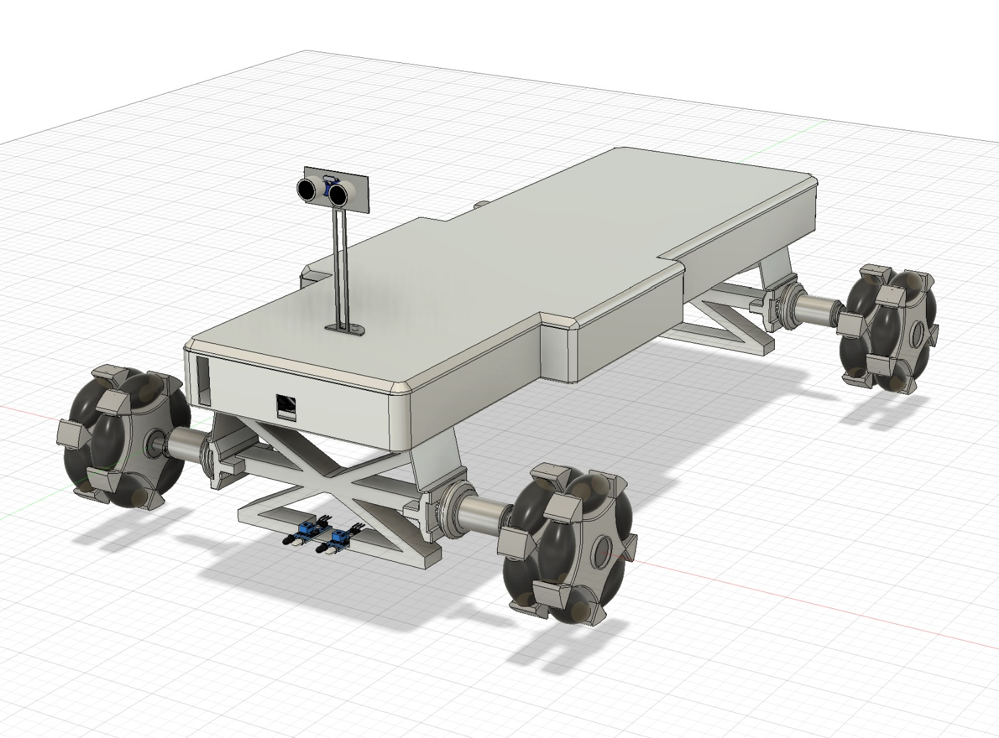
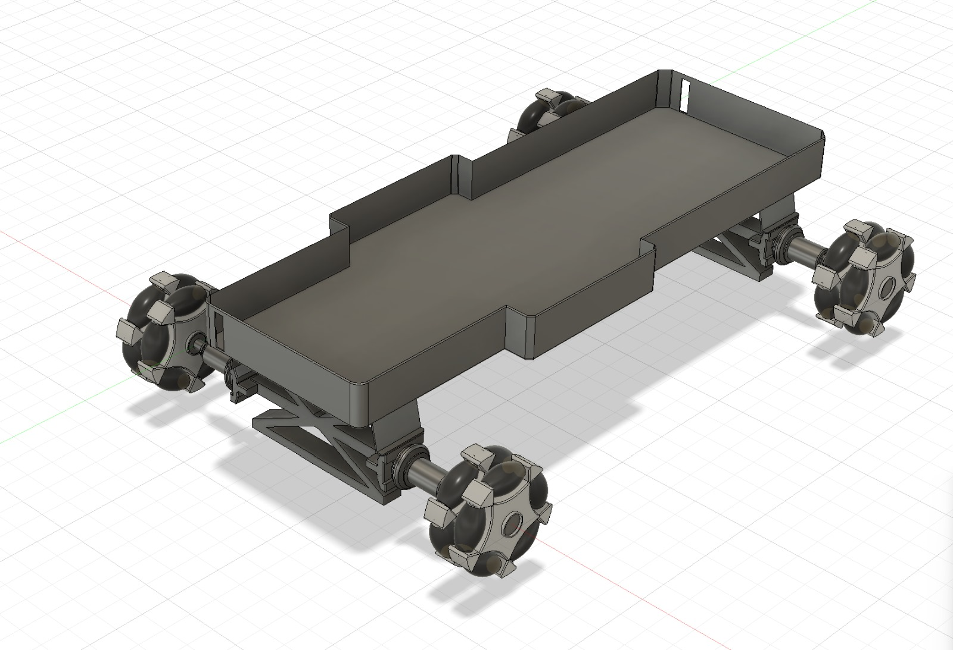
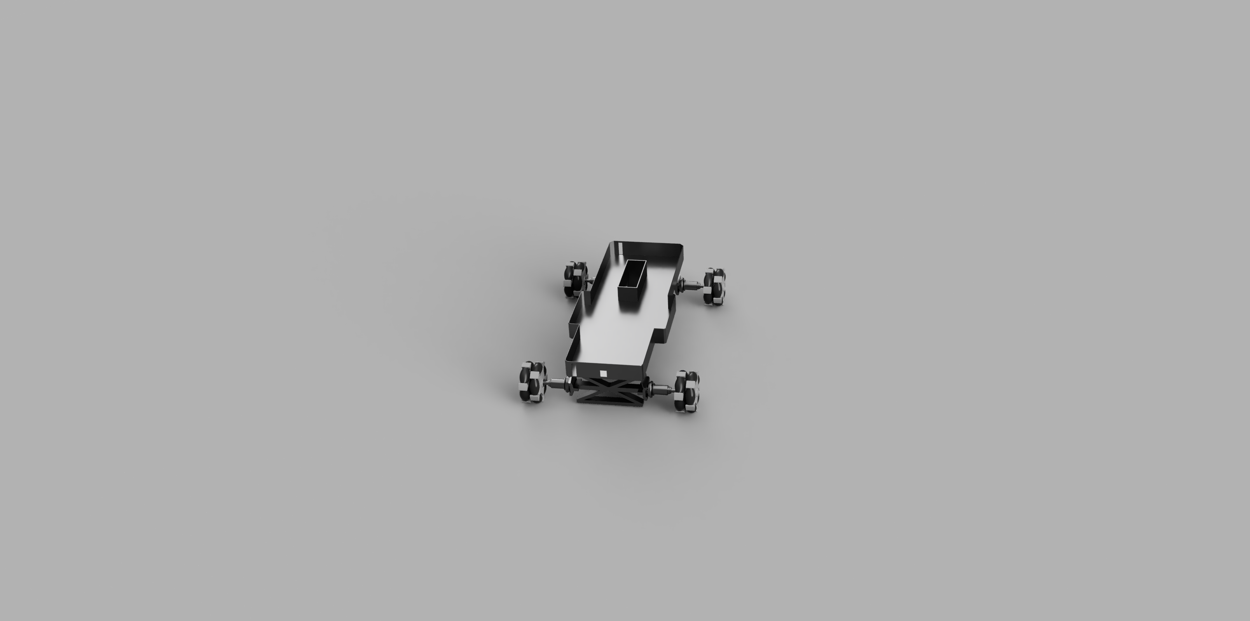
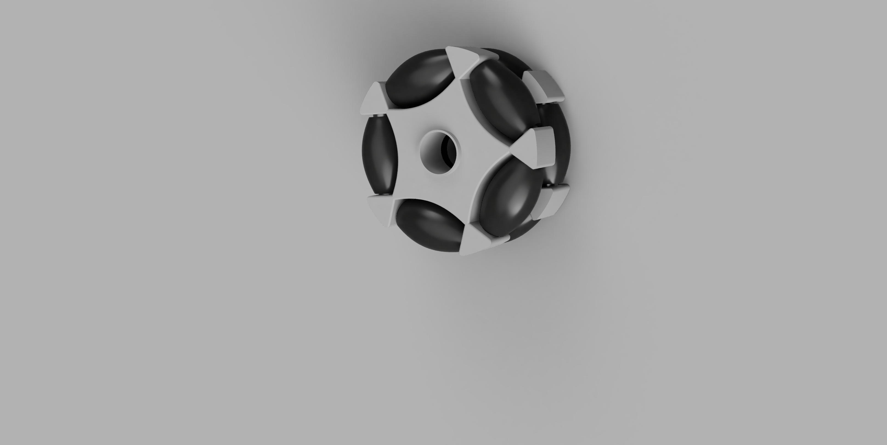
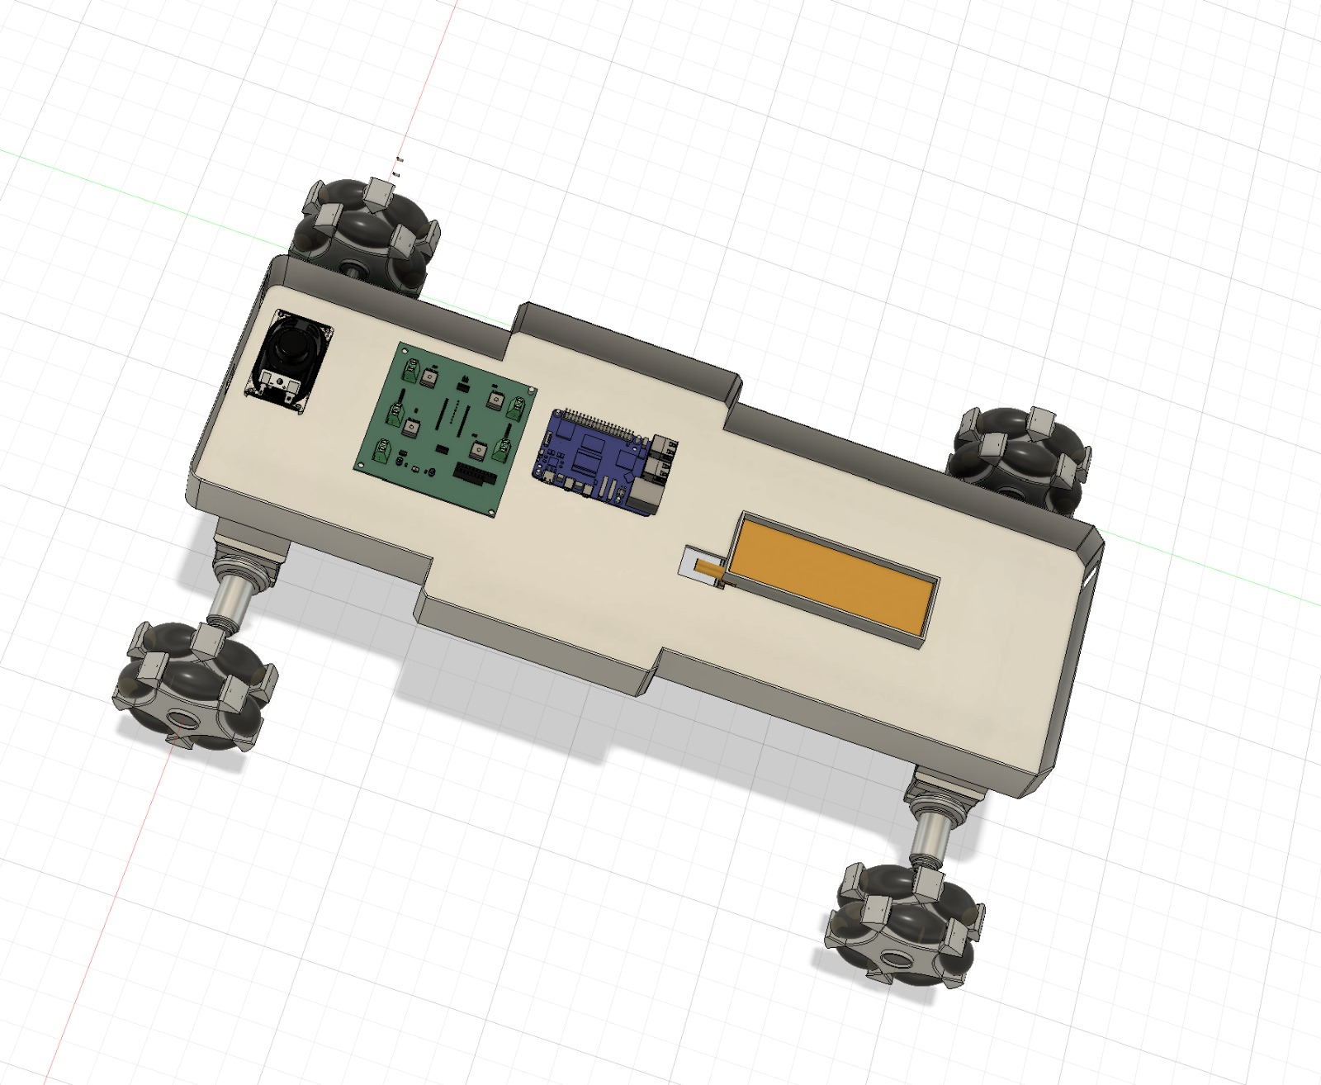
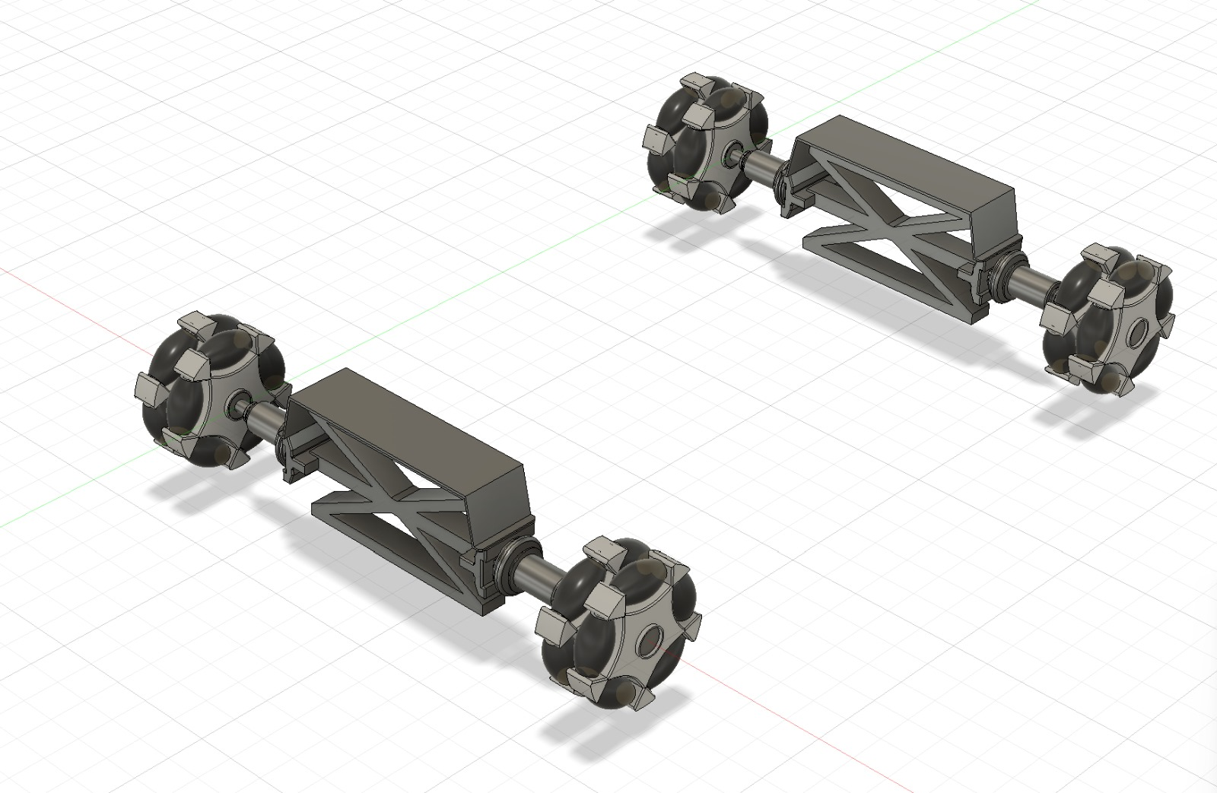
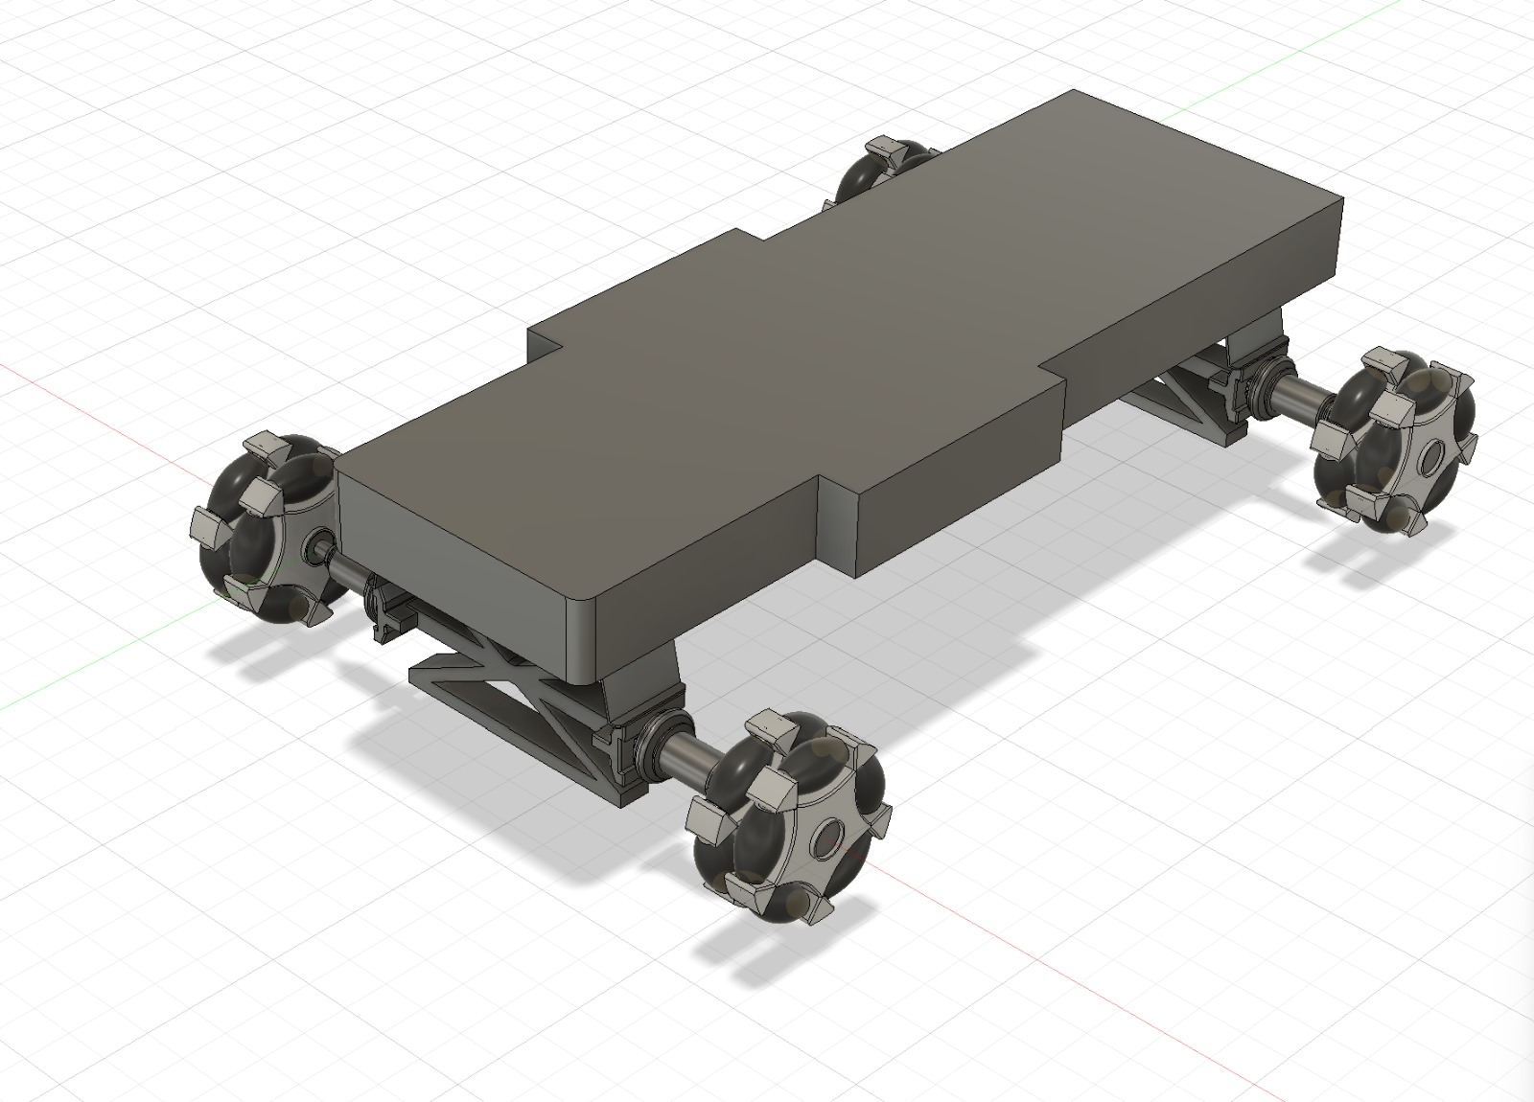
Preliminary Designs

Slide 9
Preliminary Designs

Slide 10
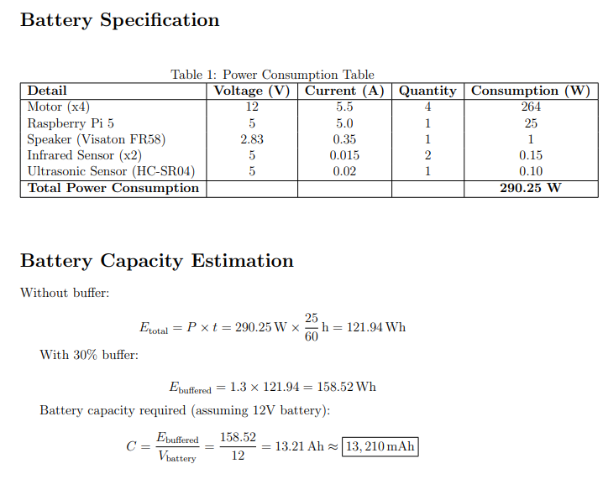
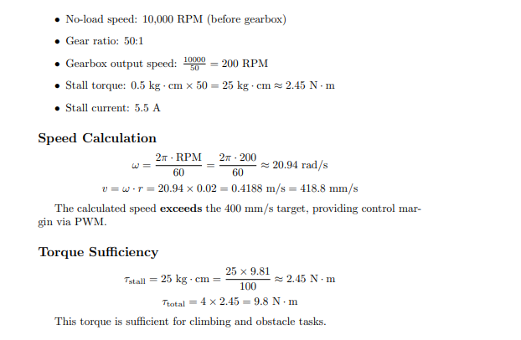
Calculations
Motor Specifications and Calculations
Weight of the robot
Motors(x4) – 440g
Wheels(x4) – 1276g
Battery - 1046g
Chassis - 500g
Electronics – 300g
wires and acessories – 200g
PCB + Casing – 200g
Total weight = 3962g

Slide 11
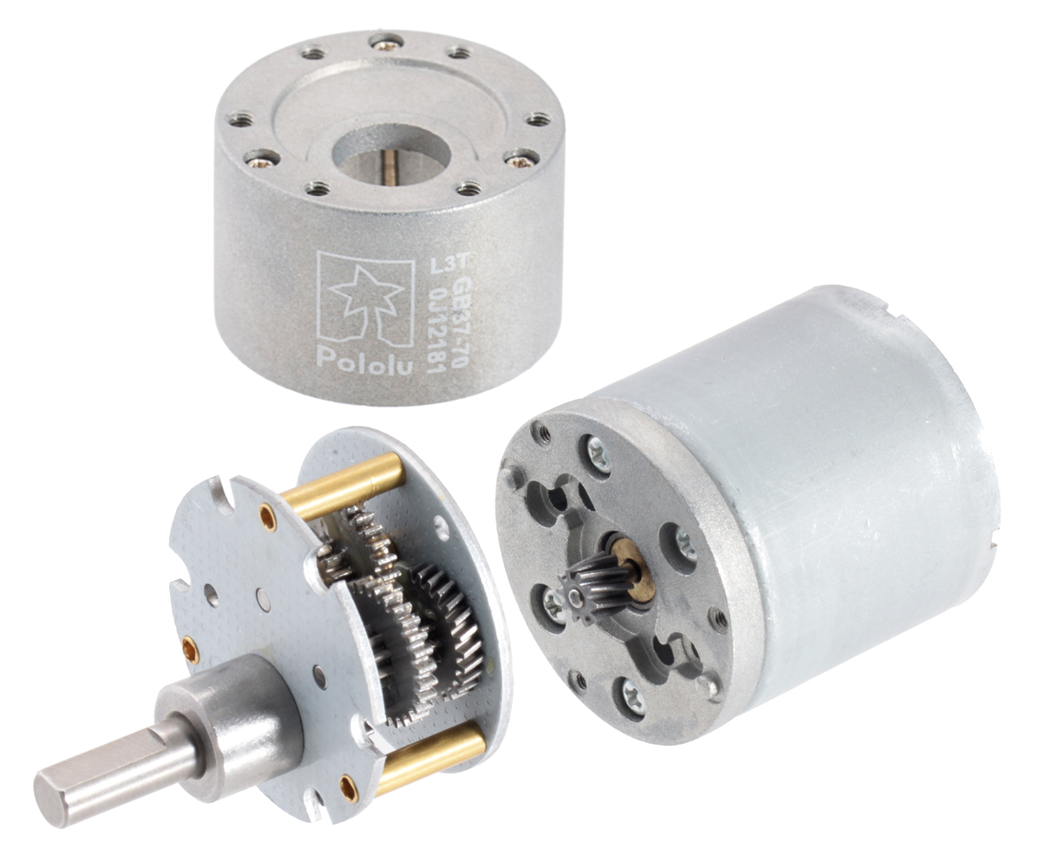
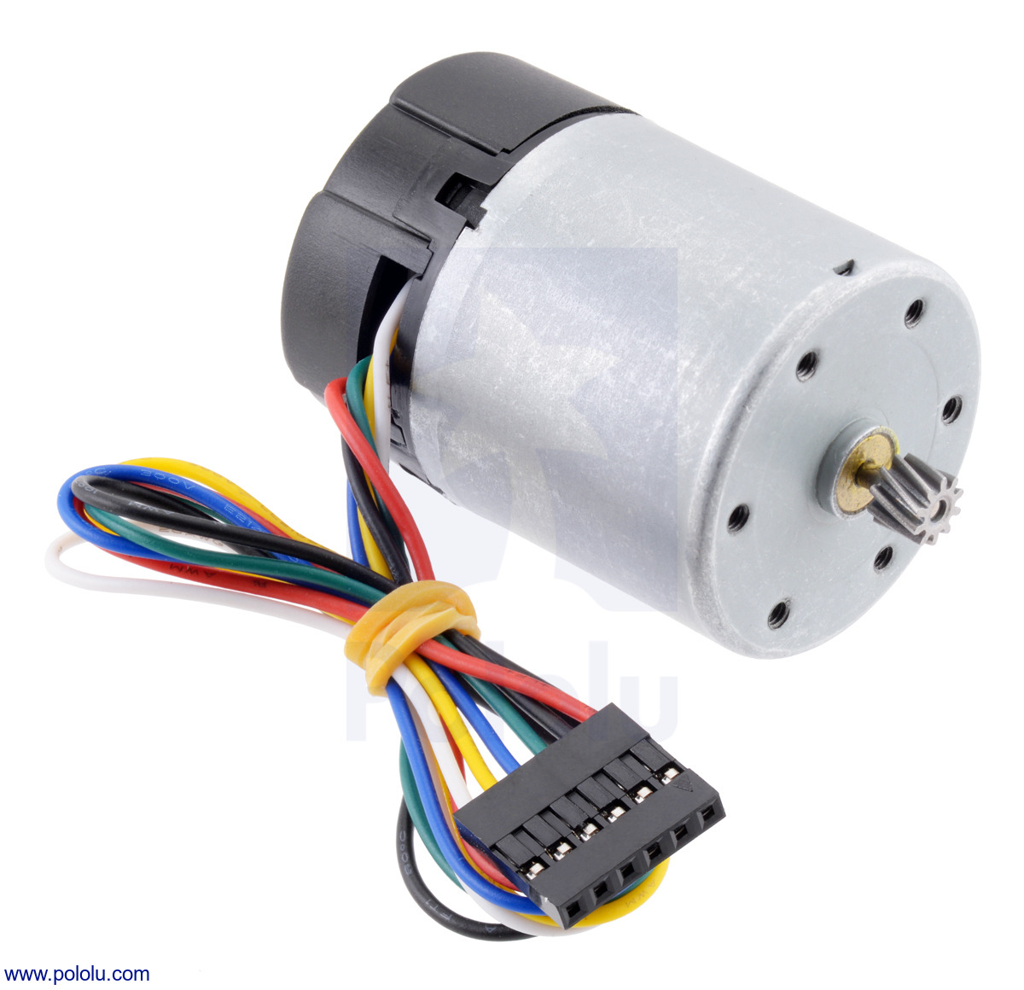
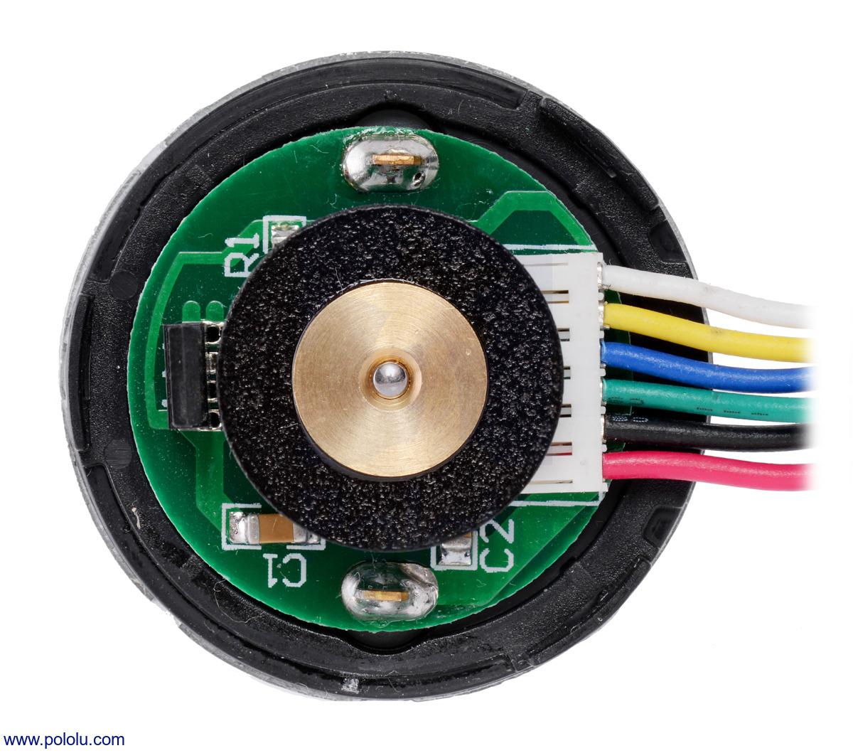
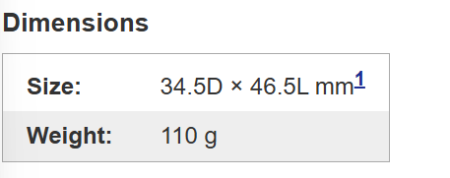
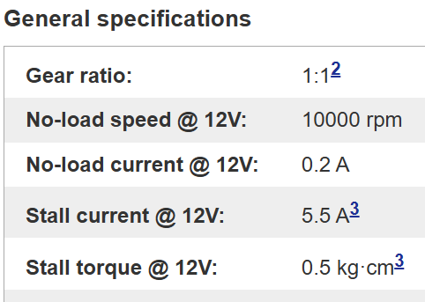
Motors
https://www.pololu.com/file/0J1736/pololu-37d-metal-gearmotors-rev-1-2.pdf

Slide 12
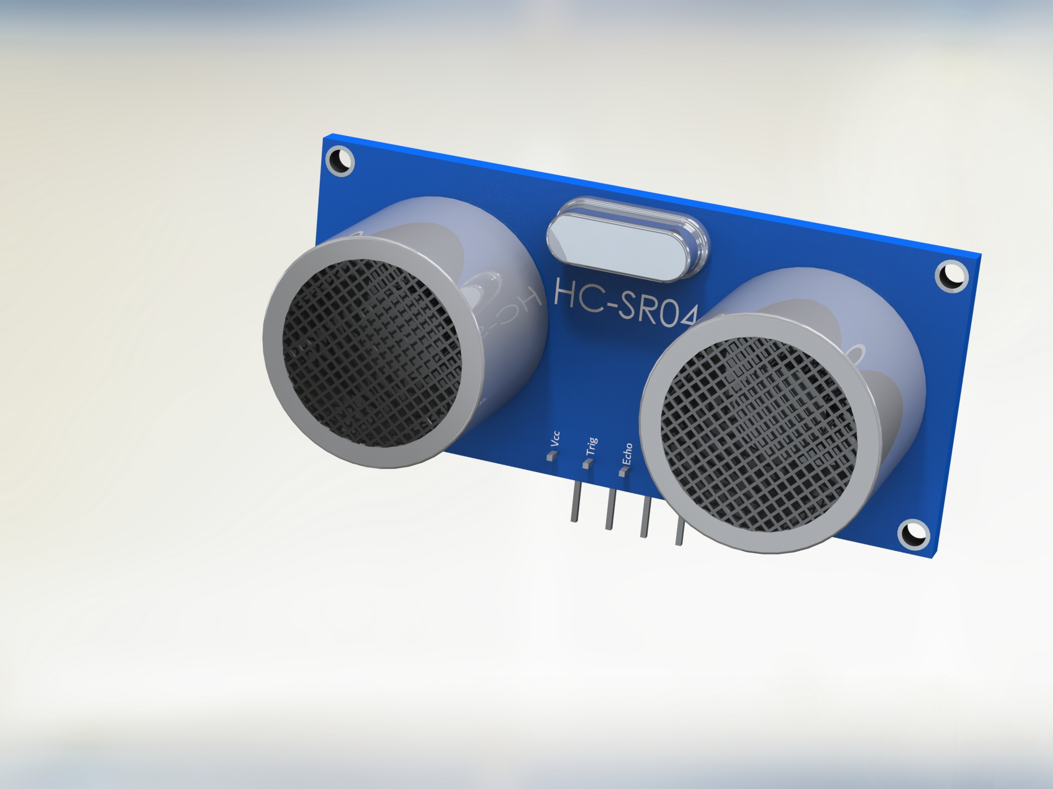
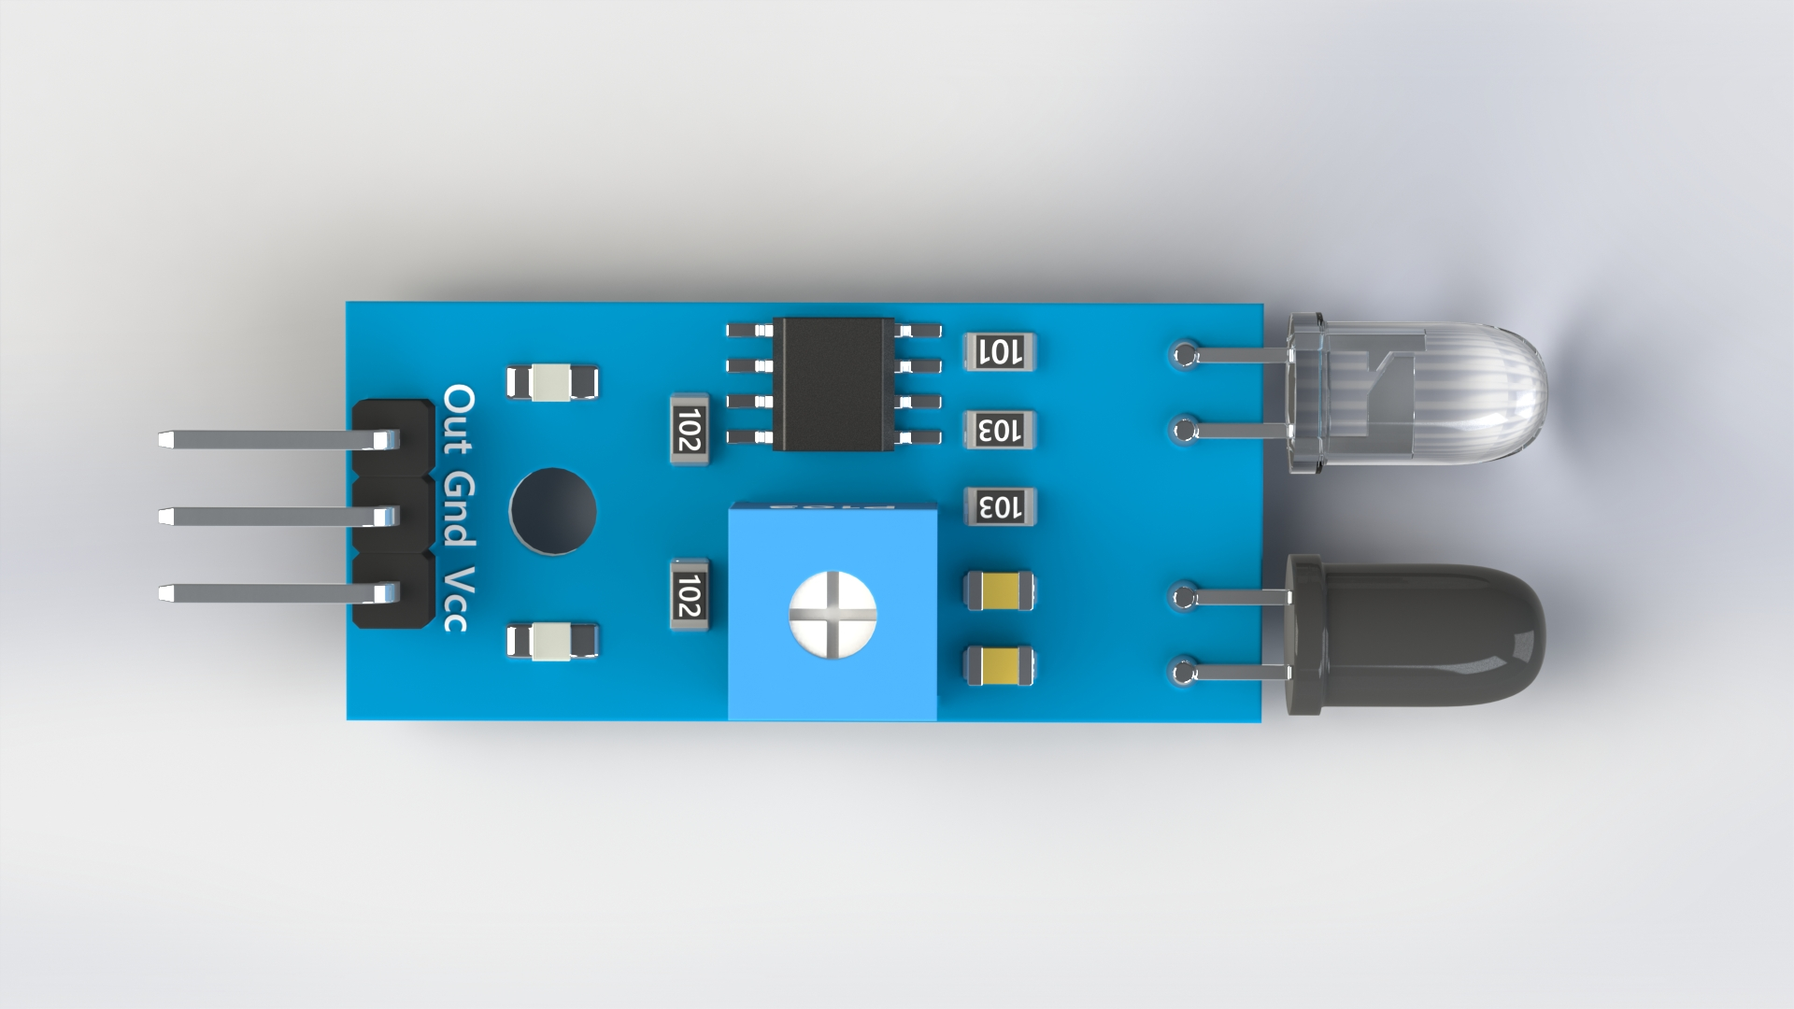
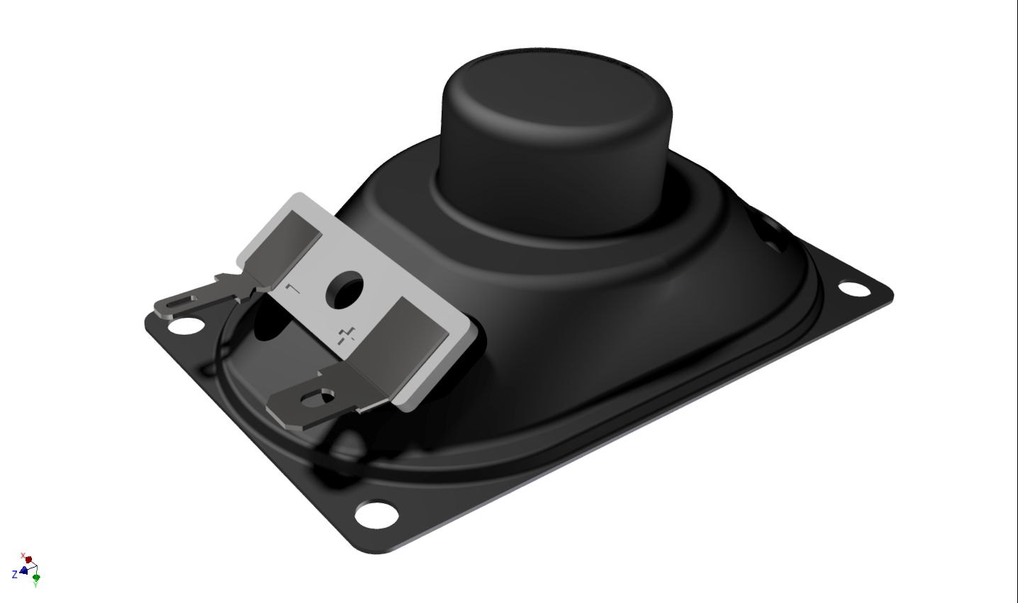
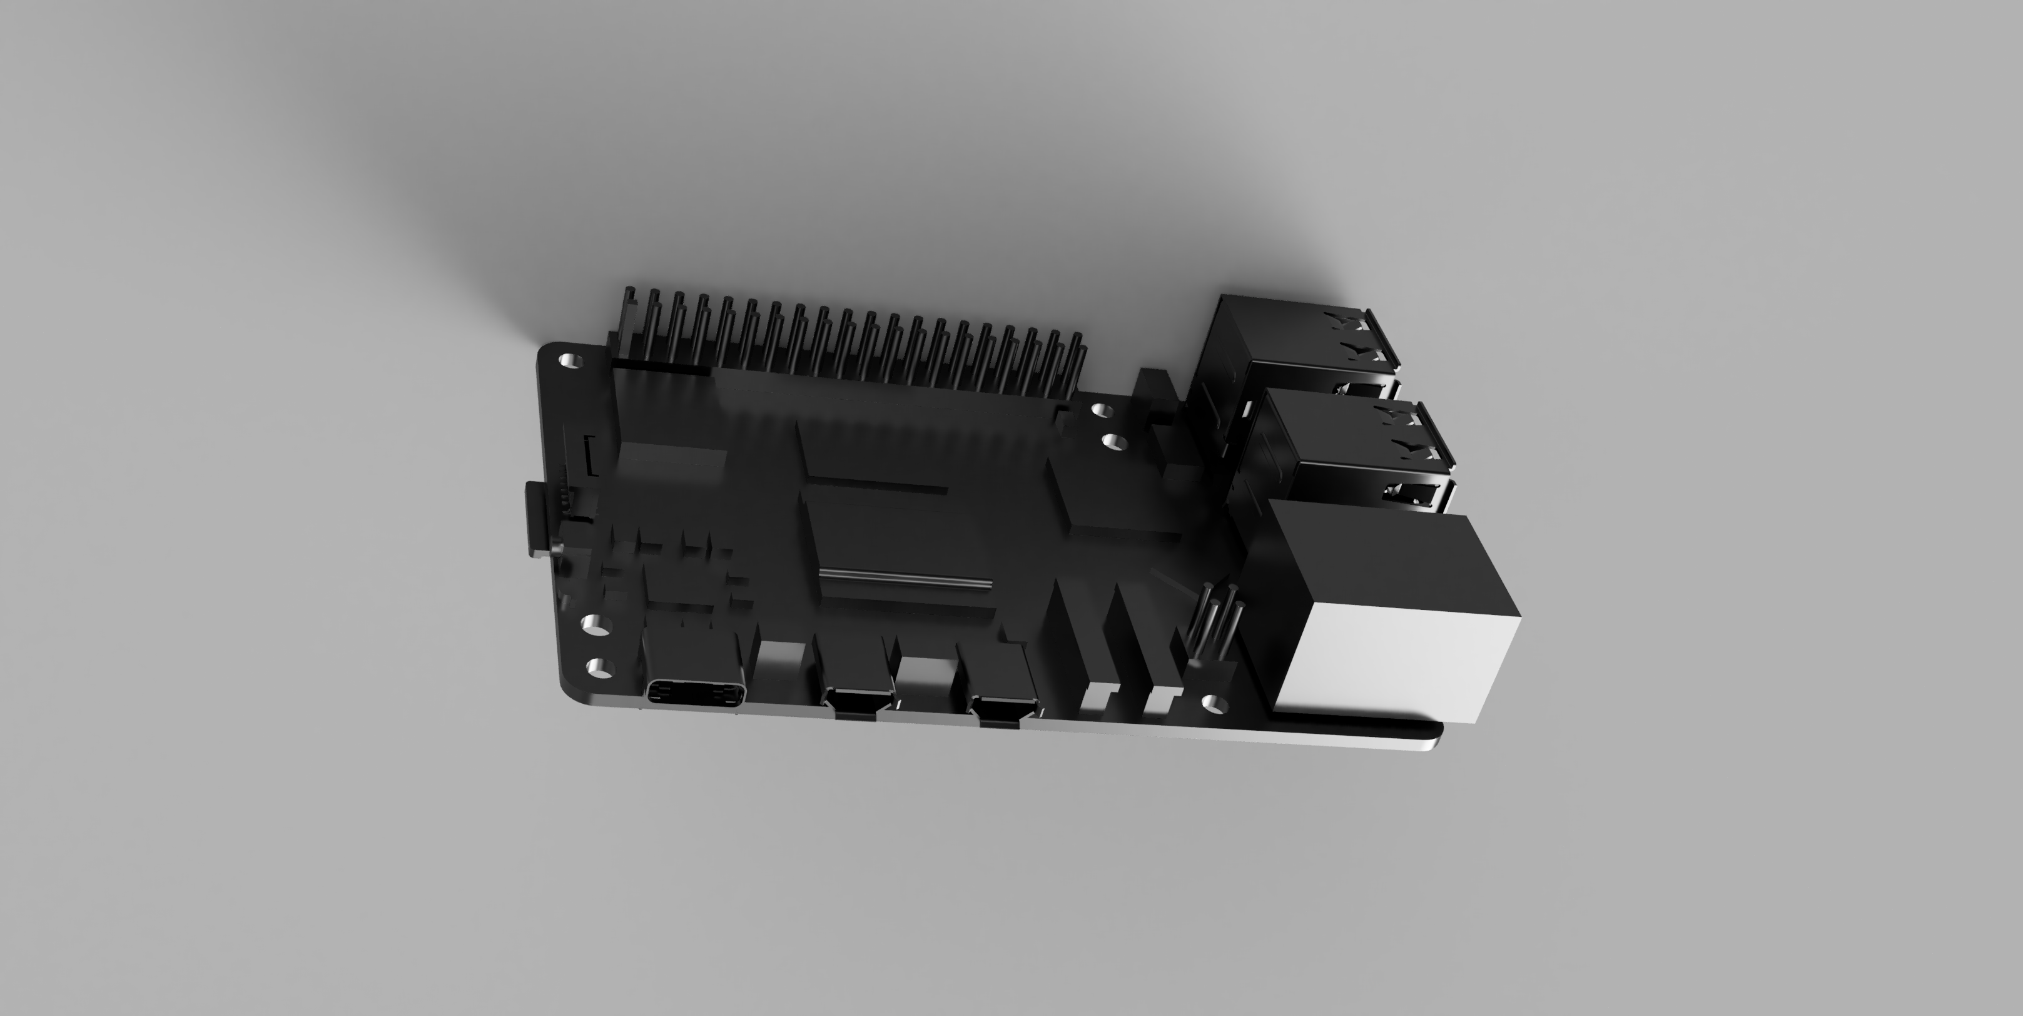
Other important parts
hc-sr04
ir-sensor
speaker
Board for rapsbery pie

Slide 13
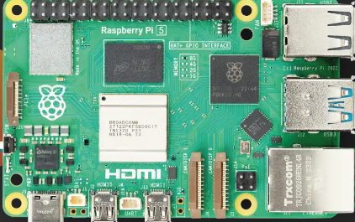
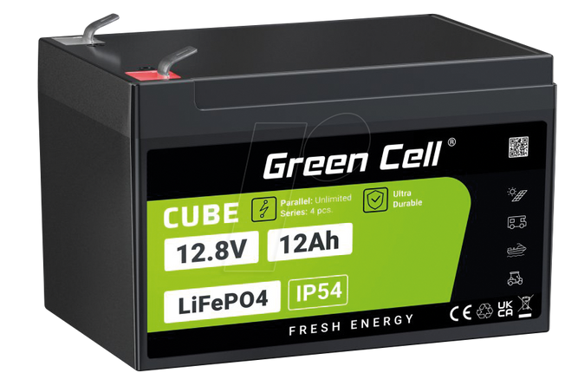
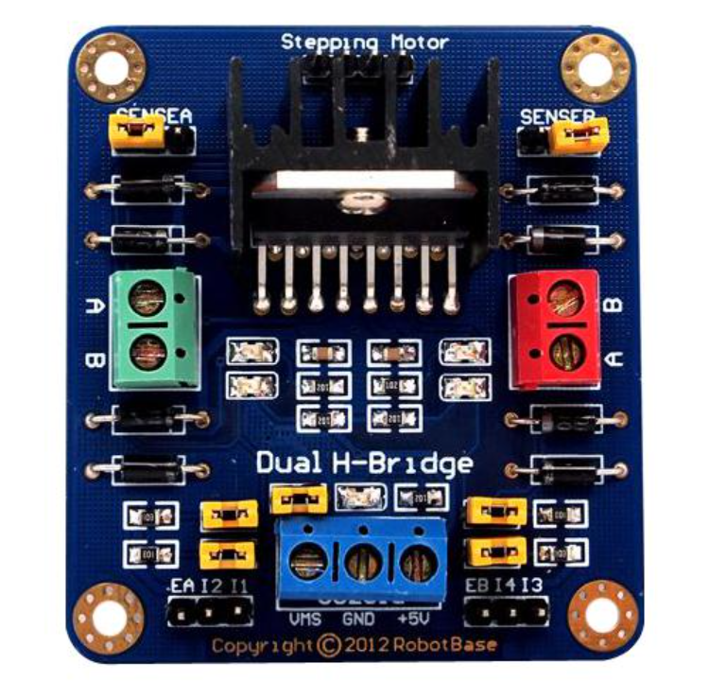
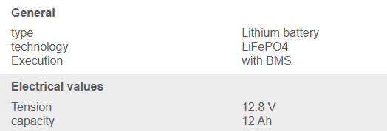
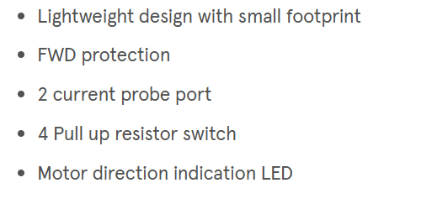
Other parts
Raspberrypi 5
Battery
H-Bridge Motor Driver,
Motor Control
SPECIFICATIONS
Broadcom BCM2712 2.4GHz quad-core 64-bit Arm Cortex-A76 CPU,
with cryptography extensions, 512KB per-core L2 caches and a 2MB shared L3 cache
VideoCore VII GPU, supporting OpenGL ES 3.1, Vulkan 1.2
Dual 4Kp60 HDMI® display output with HDR support
4Kp60 HEVC decoder
LPDDR4X-4267 SDRAM (2GB, 4GB, 8GB, and 16GB)
Dual-band 802.11ac Wi-Fi®

Slide 14
Bill of Materials(BoM)
Level | Part Number | Part Name | External Component | Unit price (€) | Quantity | Cost (€) | Source | Revision
1 | Final robot design | Final robot design + shipping cost |  | 302.02 | 1 | 302.02€ | https://jlc3dp.com/3d-printing-quote
1.1 | omnidirectional wheel | omnidirectional wheel | External | 28,14 | 4 | 112,56 | https://www.amazon.de/VGEBY-Plastic-Directional-Loading-Platform/dp/B09B22SNNY
1.1.1 | Component3 | Component3 |  |  | 2
1.1.1.1 | Component4 | Component4 |  |  | 1
1.2 | IRsensors | IRsensors CIRCUIT | External | 5,20 | 2 | 10,4 | https://www.sunfounder.com/products/ir-obstacle-avoidance-sensor-module?srsltid=AfmBOoq3mfjT3SGauPWXyfxhBpxE5STXhFqnodQTq4s_heiRgwpLcv82
1.2.1 | 90headerMale | 90headerMale |  |  | 3
1.2.2 | smdResistor103 | smdResistor103 |  |  | 2
1.2.3 | smdLED | smdLED |  |  | 2
1.2.4 | whiteLEDIRsensor | whiteLEDIRsensor |  |  | 1
1.2.5 | smdChip8pin | smdChip8pin |  |  | 1
1.2.6 | smdResistor102 | smdResistor102 |  |  | 2
1.2.7 | smdceramiccapacitor | smdceramiccapacitor |  |  | 2
1.2.8 | solder | solder |  |  | 7
1.2.9 | blackLEDIRsensor | blackLEDIRsensor |  |  | 1
1.2.10 | IRboard | IRboard |  |  | 1

Slide 15
Bill of Materials(BoM)
1.2.11 | smdResistor101 | smdResistor101 |  |  | 1
1.2.12 | smdTrimmerP103 | smdTrimmerP103 |  |  | 1
1.3 | lower body | lower body |  |  | 1
1.4 | RP-004882-DD - Pi 5 Mechanical Reference 3D model Iss1 | RaspberryPi5 | External | 43,425 | 1 | 43,425 | https://www.raspberrypi.com/products/raspberry-pi-5/
1.4.1 | SD CARD for REF | SD CARD for REF |  |  | 1
1.4.2 | Micro HDMI for REF | Micro HDMI for REF |  |  | 2
1.4.3 | GPIO Header for REF | GPIO Header for REF |  |  | 1
1.4.4 | BAT Header for REF | BAT Header for REF |  |  | 1
1.4.5 | PCB_for REF 060923 | PCB_for REF 060923 |  |  | 1
1.4.6 | RJ45 for REF | RJ45 for REF |  |  | 1
1.4.7 | PoE Header for REF | PoE Header for REF |  |  | 1
1.4.8 | UART for REF | UART for REF |  |  | 1
1.4.9 | FAN Header for REF | FAN Header for REF |  |  | 1
1.4.10 | CAM-DISP for REF | CAM-DISP for REF |  |  | 2
1.4.11 | SWITCH for REF | SWITCH for REF |  |  | 1
1.4.12 | USB for REF | USB for REF |  |  | 2
1.4.13 | USB-C for REF | USB-C for REF |  |  | 1
1.4.14 | PCIe for REF | PCIe for REF |  |  | 1
1.4.15 | LED for REF | LED for REF |  |  | 1

Slide 16
Bill of Materials(BoM)
1.5 | Visaton SC 4.7 ND Speaker | Visaton SC 4.7 ND Speaker | External | 9,4 | 1 | 9,4 | https://www.thomann.de/at/visaton_fr_58.htm
1.6 | omnidirectional wheels | Utrasonic sensor stand |  |  | 1
1.6.1 | Component2 | Component2 |  |  | 1
1.6.2 | Component3 | Component3 |  |  | 1
1.6.3 | Component1 | Component1 |  |  | 1
1.7 | hc-sr04 | hc-sr04 | External | 4,56 | 1 | 4,56 | https://www.sparkfun.com/ultrasonic-distance-sensor-hc-sr04.html
1.8 | joint for wheel and motor 3 | joint for wheel and motor 3 |  |  | 1
1.9 | Robot top cover | Robot top cover |  |  | 1
1.10 | wheel pin 4 | wheel pin 4 |  |  | 1
1.11 | Component11 | Component11 |  |  | 1
1.12 | wheel pin 3 | wheel pin 3 |  |  | 1
1.13 | joint for wheel and motor 4 | joint for wheel and motor 4 |  |  | 1
1.14 | wheel pin 1 | wheel pin 1 |  |  | 1
1.15 | wheel pin 2 | wheel pin 2 |  |  | 1
1.16 | Battery | Battery | External | 61,21 | 1 | 61,21 | https://www.reichelt.at/at/de/shop/produkt/lithium-akku_lifepo4_12_8_v_12_ah-384572?PROVID=2807&gad_source=1&gad_campaignid=20946573290&gbraid=0AAAAADwnxtYfnj8iPh_8jzfgkG_GJi2P3&gclid=EAIaIQobChMIouiJzff_jQMV-8c8Ah2NDA7GEAQYBCABEgK-EPD_BwE
1.17 | Demo 1 | H birdge and power control circuit | External | 22,45 | 1 | 22,45 | https://at.farnell.com/en-AT/seeed-studio/105990007/development-board-h-bridge-motor/dp/4060368?srsltid=AfmBOopHic4Oi2Be9k9MpBgd6GNuSE0dnHD5-GgU6ukIC0DXjSnTEdhE
1.17.1 | PinSocket_1x24_P1.00mm_Vertical | PinSocket_1x24_P1.00mm_Vertical |  |  | 2
1.17.2 | C_Radial_D4.0mm_H5.0mm_P1.50mm | C_Radial_D4.0mm_H5.0mm_P1.50mm |  |  | 2
1.17.3 | C_0805_2012Metric | C_0805_2012Metric |  |  | 2
1.17.4 | PinSocket_1x08_P2.54mm_Vertical | PinSocket_1x08_P2.54mm_Vertical |  |  | 2
1.17.5 | PinSocket_1x04_P2.00mm_Vertical | PinSocket_1x04_P2.00mm_Vertical |  |  | 4
1.17.6 | Infineon_PG-TO-220-7Lead_TabPin8 | Infineon_PG-TO-220-7Lead_TabPin8 |  |  | 4
1.17.6.1 | Demo 1.6.1 | Demo 1.6.1 |  |  | 1
1.17.7 | TerminalBlock_Phoenix_MKDS-1,5-2_1x02_P5.00mm_Horizontal | TerminalBlock_Phoenix_MKDS-1,5-2_1x02_P5.00mm_Horizontal |  |  | 5
1.17.8 | D_SMA | D_SMA |  |  | 1
1.17.9 | R_1206_3216Metric | R_1206_3216Metric |  |  | 4
1.17.10 | SOT-89-3 | SOT-89-3 |  |  | 1
1.17.10.1 | Demo 1.8.1 | Demo 1.8.1 |  |  | 1
1.17.11 | Demo_PCB | Demo_PCB |  |  | 1
1.17.12 | PinHeader_1x02_P2.00mm_Vertical | PinHeader_1x02_P2.00mm_Vertical |  |  | 1
1.17.13 | PinSocket_1x11_P2.54mm_Vertical | PinSocket_1x11_P2.54mm_Vertical |  |  | 1
1.18 | joint for weel and motor | joint for weel and motor |  |  | 1
1.19 | joint for wheel and motor 2 | joint for wheel and motor 2 |  |  | 1
 |  | Screws |  | 0,039 | 25 | 0,975 | https://at.rs-online.com/web/p/maschinenschrauben/9087637?cm_mmc=AT-PLA-DS3A-_-google-_-CSS_AT_DE_Pmax_Test-_--_-9087637&matchtype=&&gad_source=1&gad_campaignid=20298205821&gbraid=0AAAAADkeWNOusA-vOqfDfNz9wzmiB138P&gclid=EAIaIQobChMIobLssJaAjgMVK09IAB2_UwMZEAQYASABEgLiMPD_BwE&gclsrc=aw.ds
h |  | Pcb printing + shipping cost |  | 19,81 |  | 19,81 | https://portal.multi-circuit-boards.eu/?gad_source=1&gad_campaignid=6459884386&gbraid=0AAAAACqjuZESwC78PP8LQmcM7O9uQRz29&gclid=EAIaIQobChMIzeK1kPv_jQMVRaaDBx0toh3uEAAYASAAEgLxKfD_BwE
 |  | Miscellaneous |  |  |  | 300
 |  | Total cost of the project |  |  |  | 886.64

Slide 17
Tunde Derrick CAD DESIGN

Slide 18
CAD design summary:
Autodesk Fusion 360 was used to generate a chassis that is light, strong, and modular.
Key Features:
Rectangular footprint: 50x60 cm
Mounts for omnidirectional wheels (4) and drive motors
Dedicated compartments for PCB, battery, IMU, and speaker
Acoustic chamber design to amplify sound output
Exploded views and animations for documentation Materials:
3D Printed PLA for structural frame
Aluminum rods for strength reinforcement
Mounts and connectors designed with tolerances for printed parts His mechanical structure respected the projects footprint and mass limits while enabling sensor alignment and power component cooling.

Slide 19

Robot without components
Omnidirectional wheels
Motor and axel connector
Robot Chassis

Slide 20
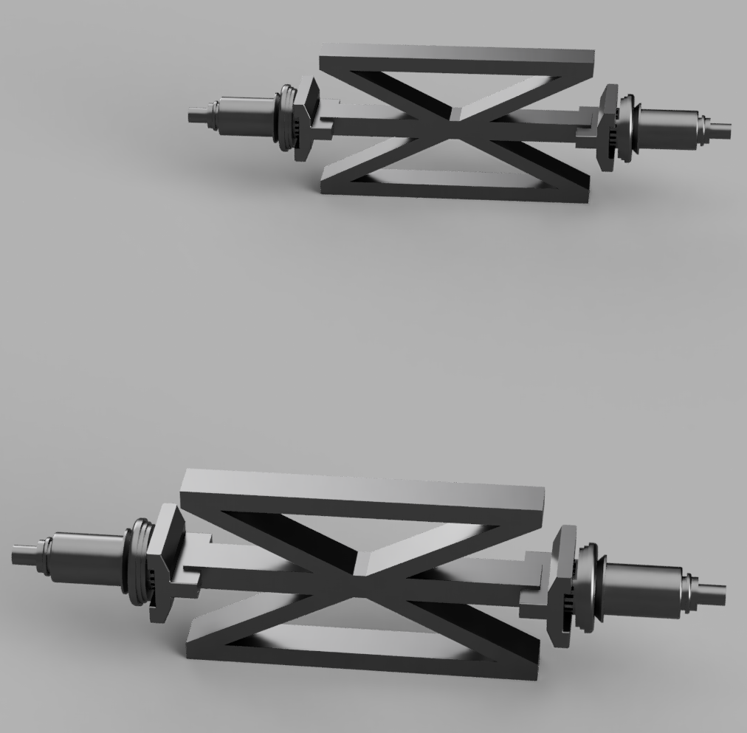
Stand
Wheel

Slide 21
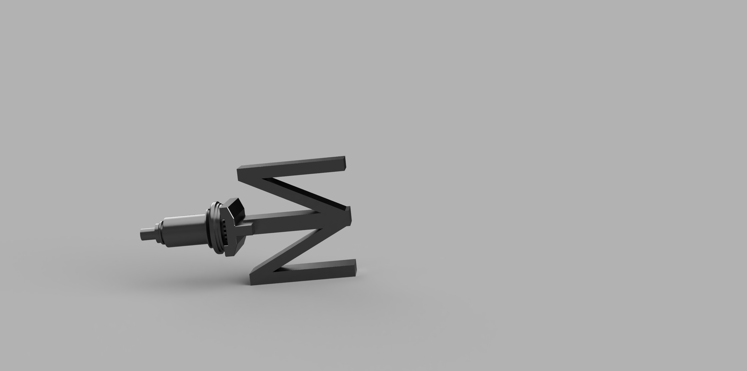
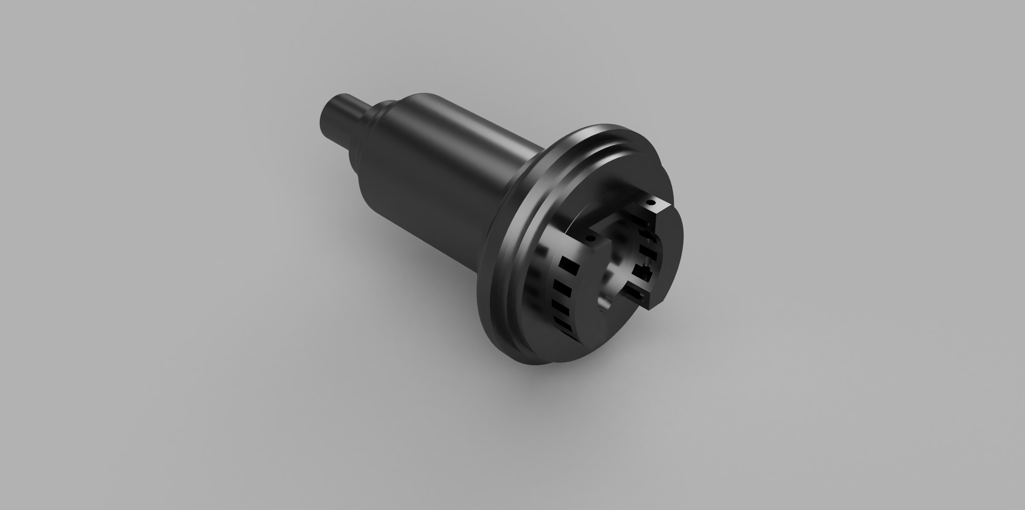
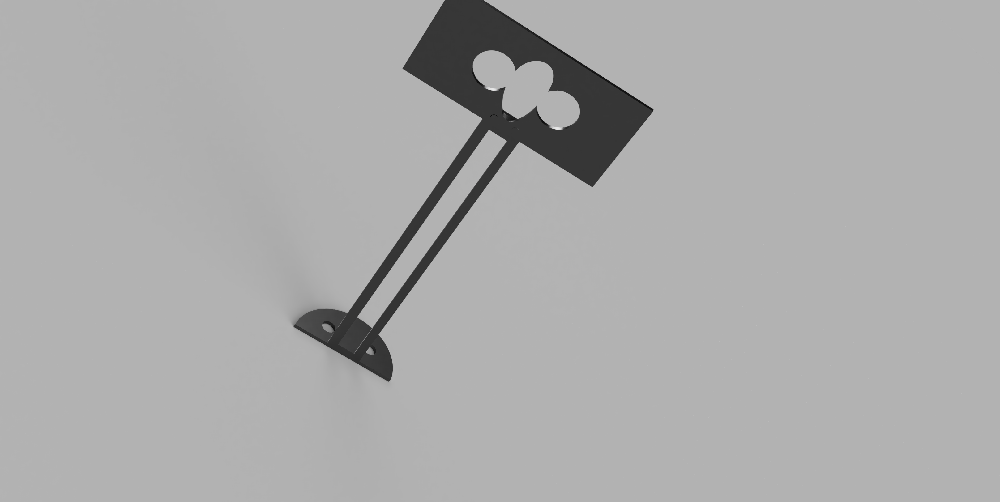
Motor and connector
Motor and axel connector
Sensor stand

Slide 22
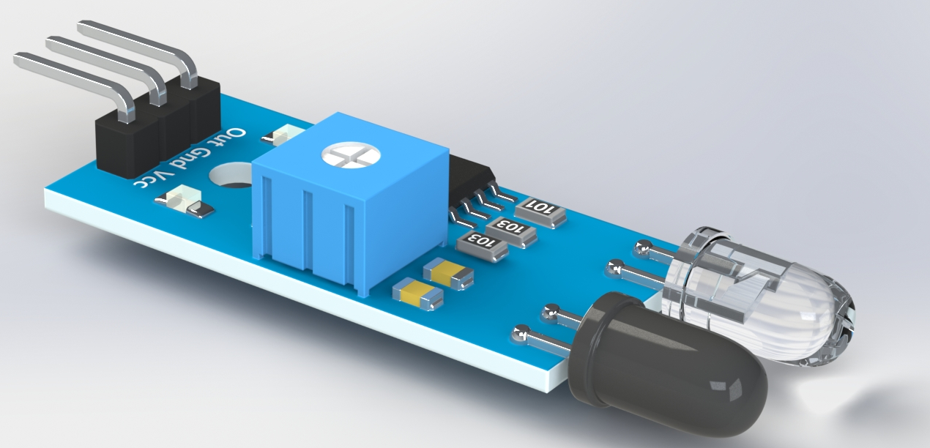
Hc sensor
Side view of infrared sensor
Top view of infrared sensor

Slide 23
Board for raspberry pie
Speaker

Slide 24
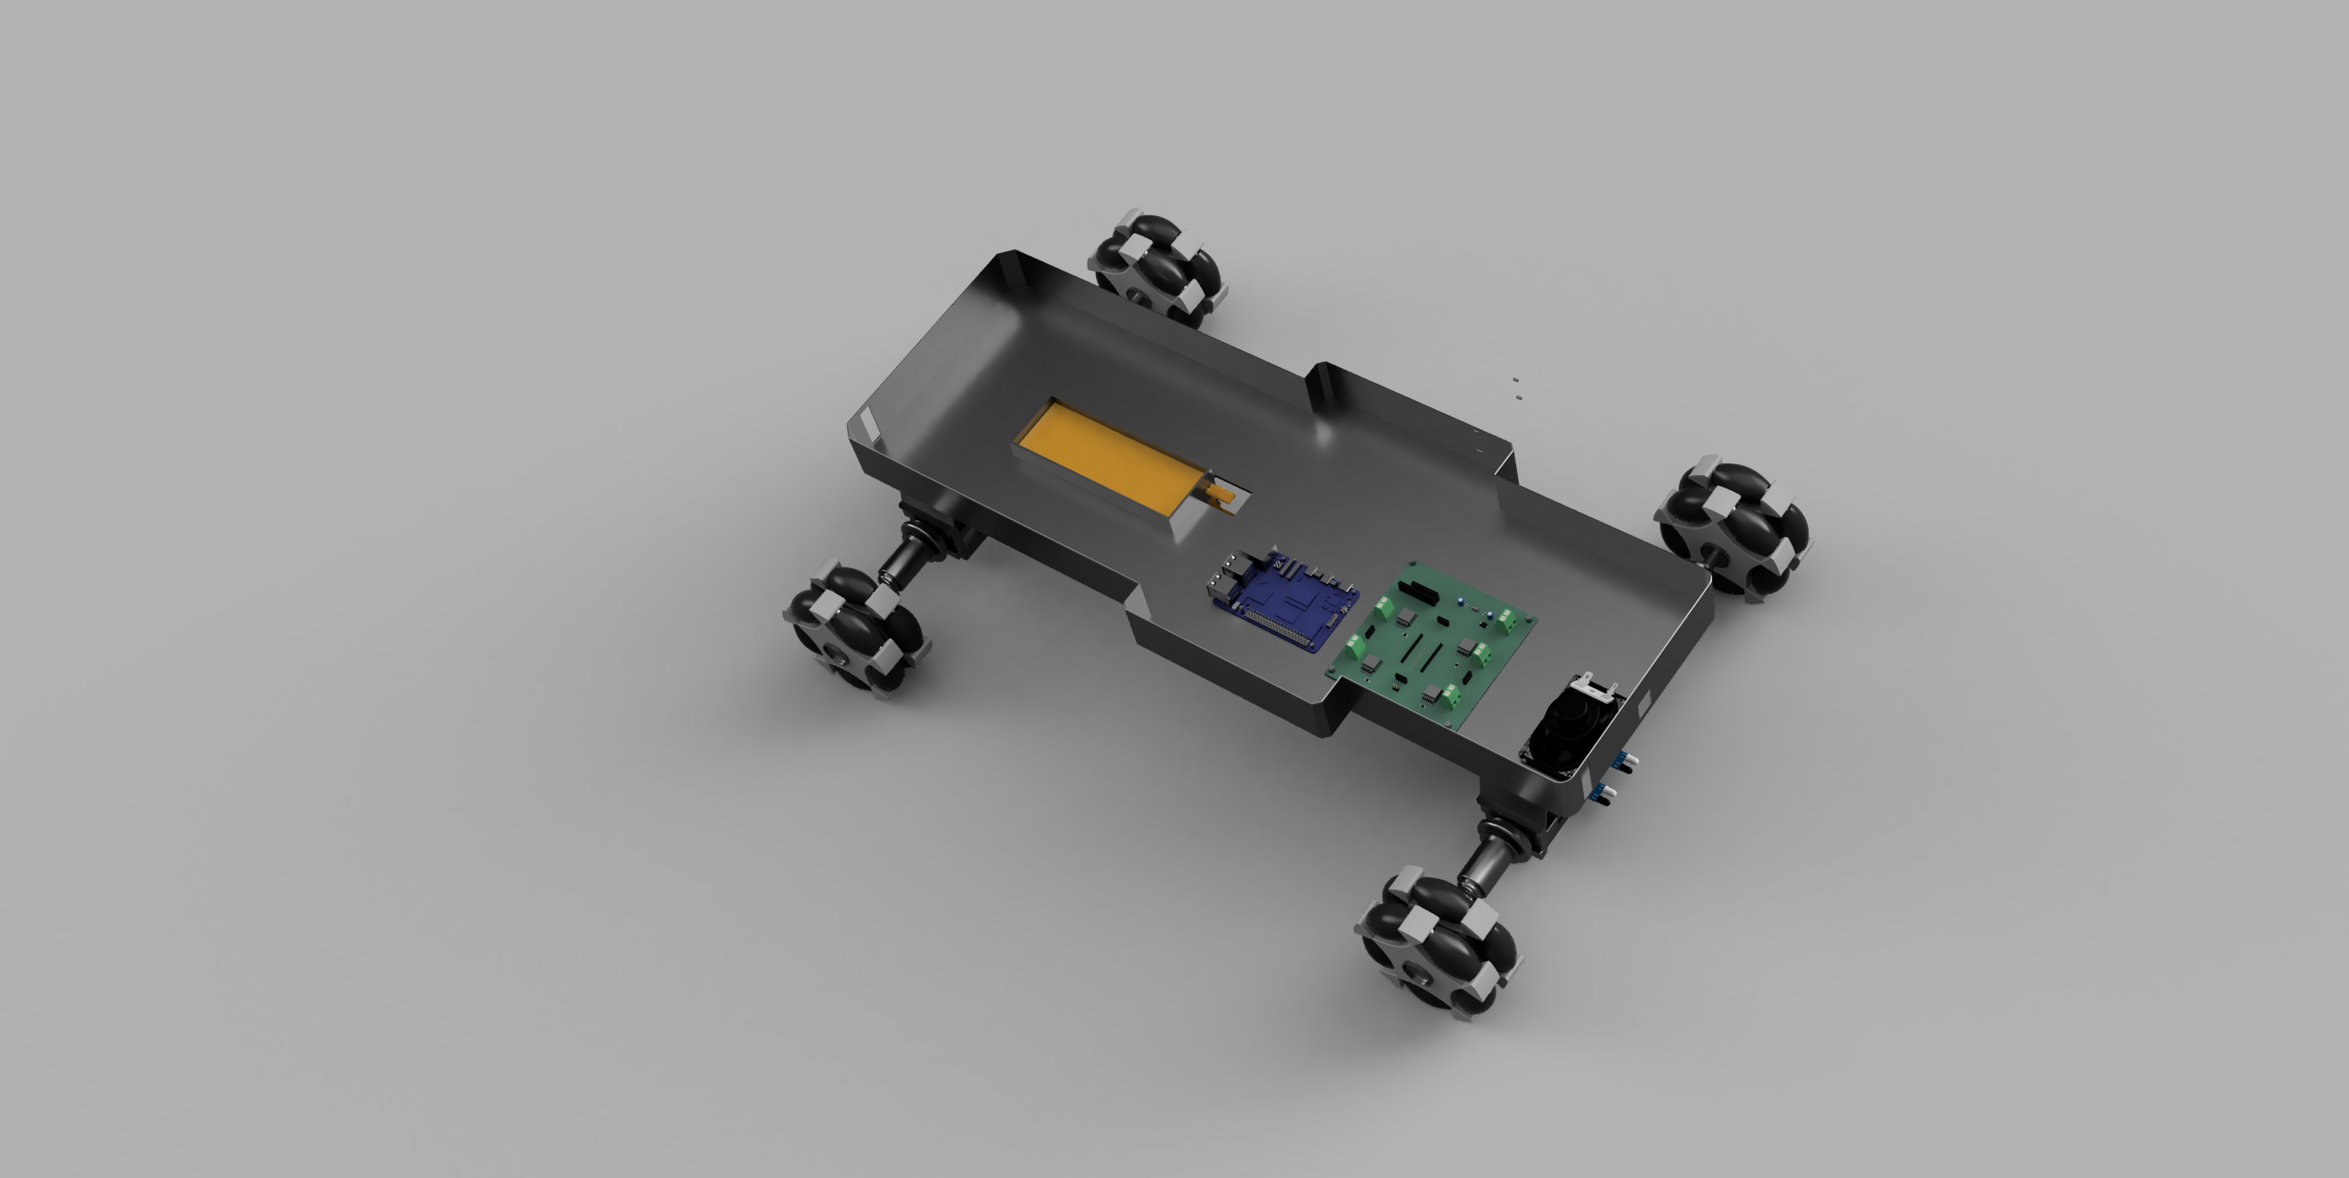
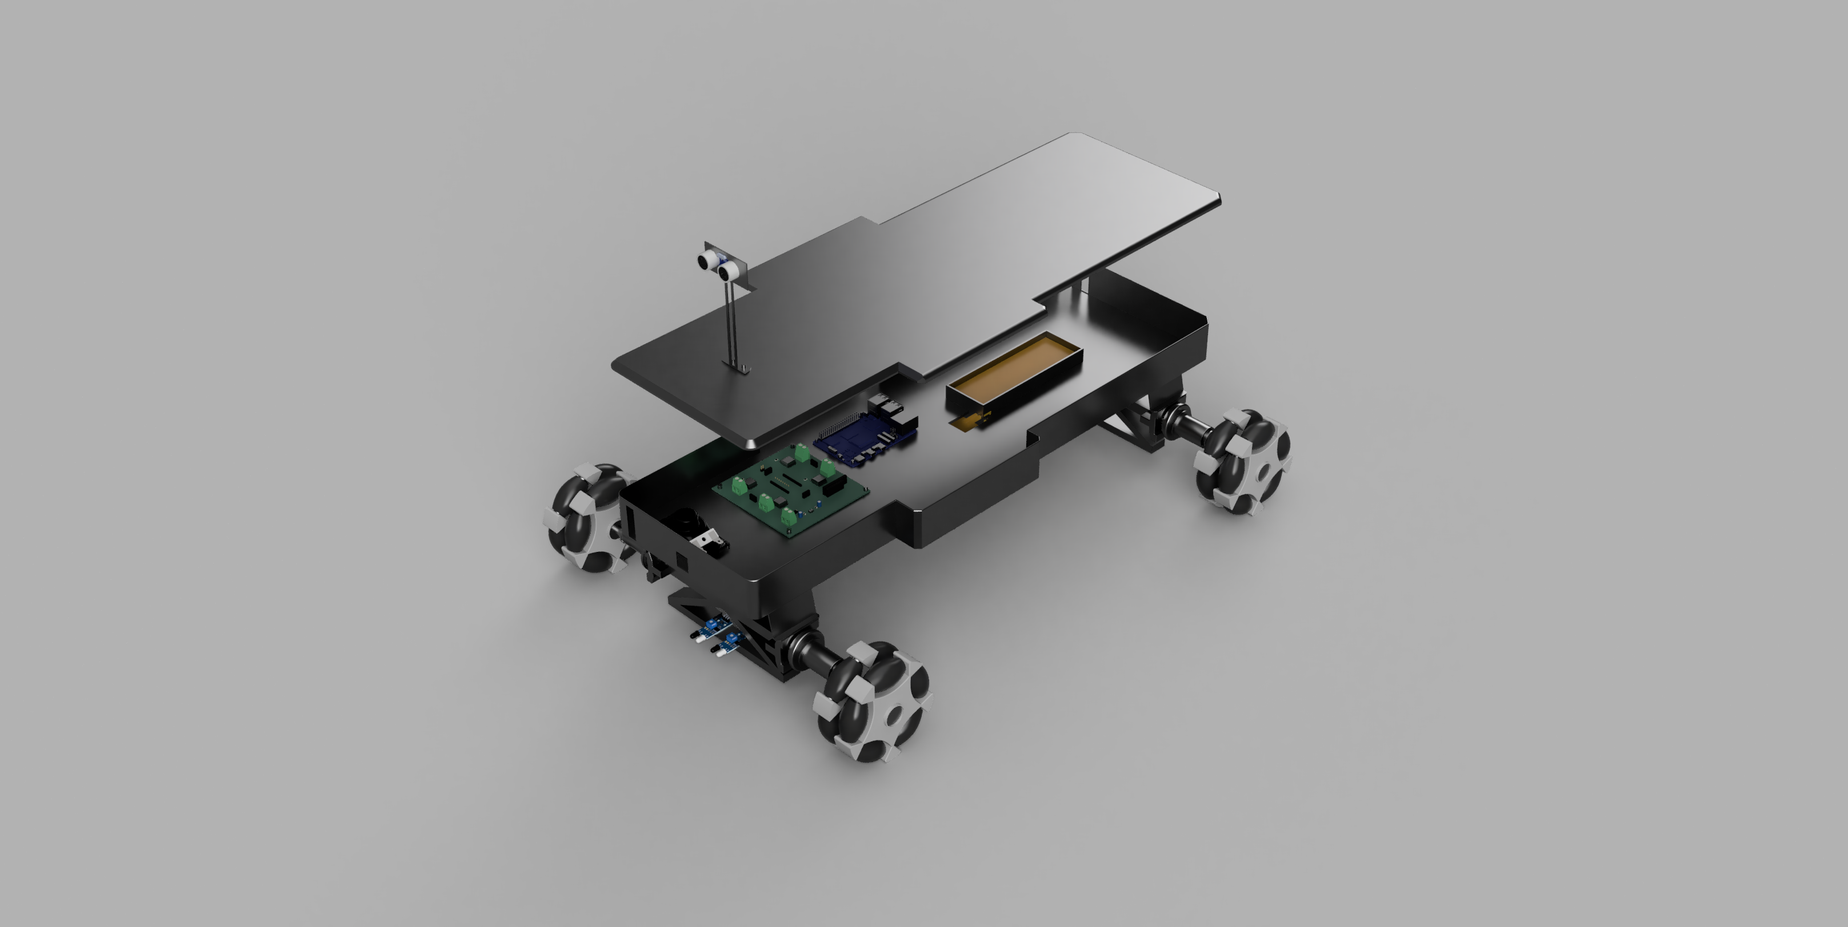
Robot with components
Robot with top cover

Slide 25
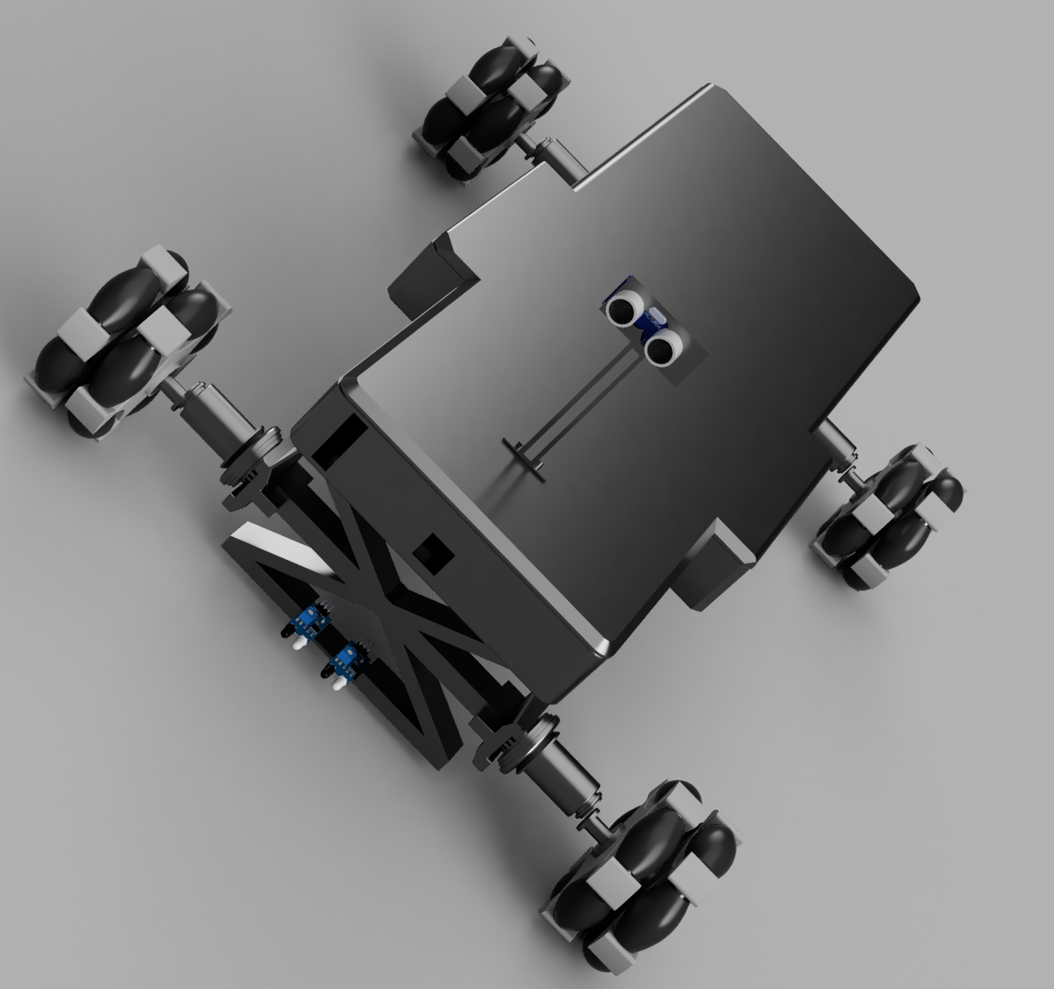
Full Robot view

Slide 26
Sathiyamoorthi Shanmugapriya PCB Design

Slide 27
PCB design summary:
The PCB was designed using KiCad. Its electronics subsystems is structured to handle sensory inputs, motor control, and feedback.
Key Elements of the PCB Design:
Four BTS7960 motor drivers for each omnidirectional wheel
Four ultrasonic distance sensors (HC-SR04) for clearance
QTR-8RC array for line tracking
Speaker output for 85 dB feedback
IMU (MPU6050) to monitor orientation and motion
Teensy 4.1 microcontroller as central controller
Compact layout within 20x25x10 cm3 reserved volume Schematic and PCB Layout:
Optimized routing for power, signal, and feedback
Ground planes and decoupling capacitors ensured signal integrity
KiCad 3D render and schematic confirmed all connections and spacing.
This design facilitated smooth integration into the chassis of the robot.

Slide 28
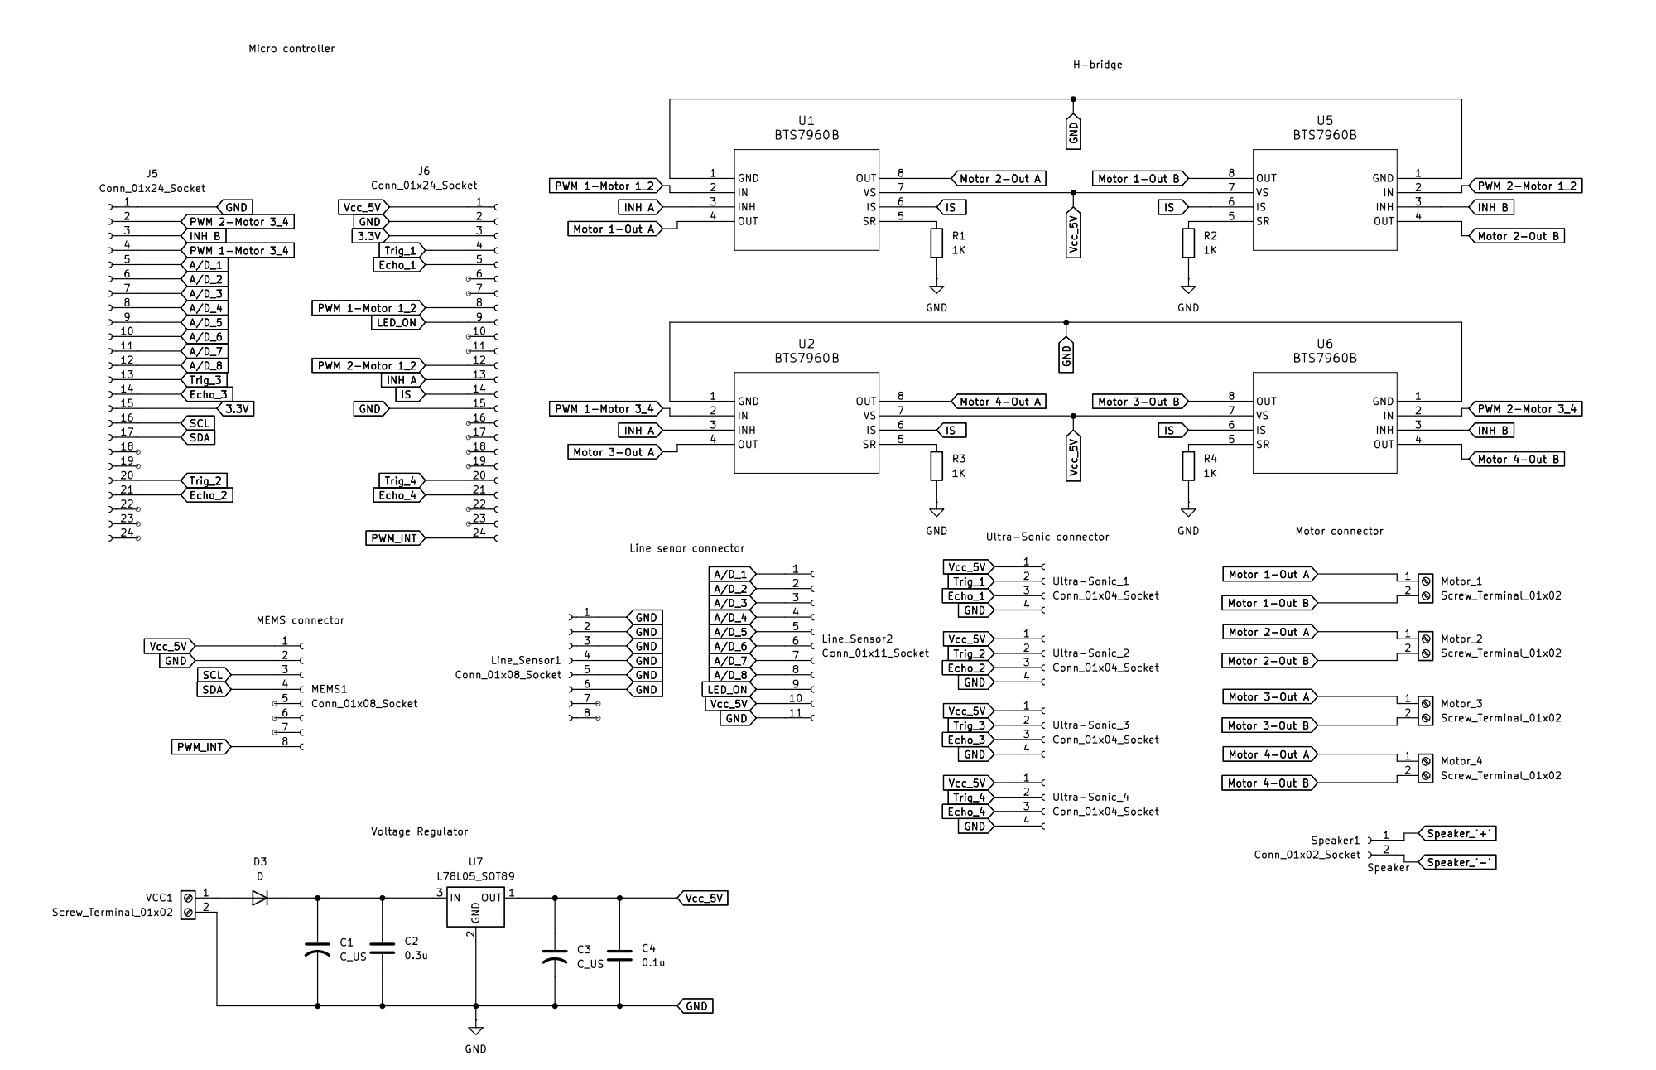
Schematic
H-Bridge
Microcontroller
Line sensor
Motor
Mems
Voltage Regulator
Ultra sonic

Slide 29
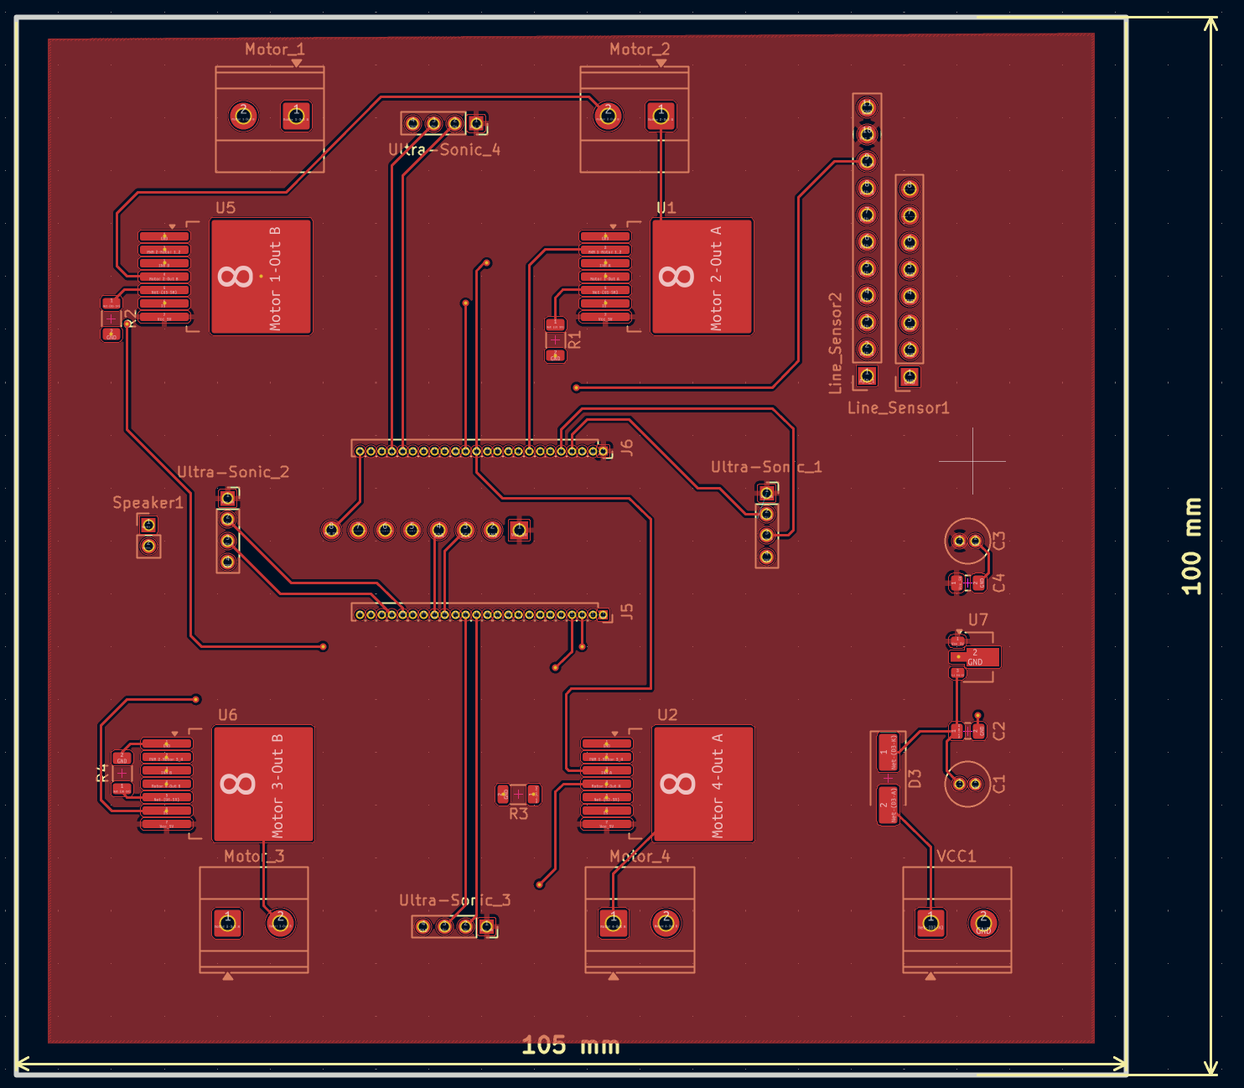
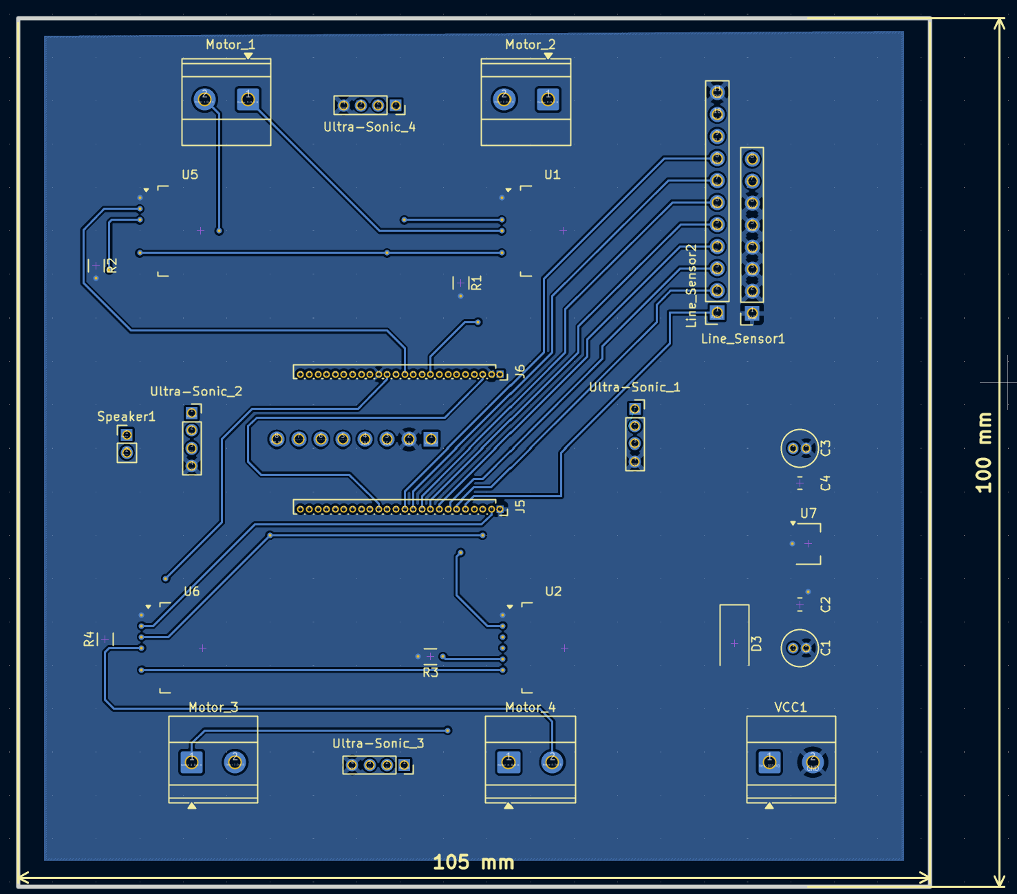
2D View: Top Layer & Bottom Layer

Slide 30
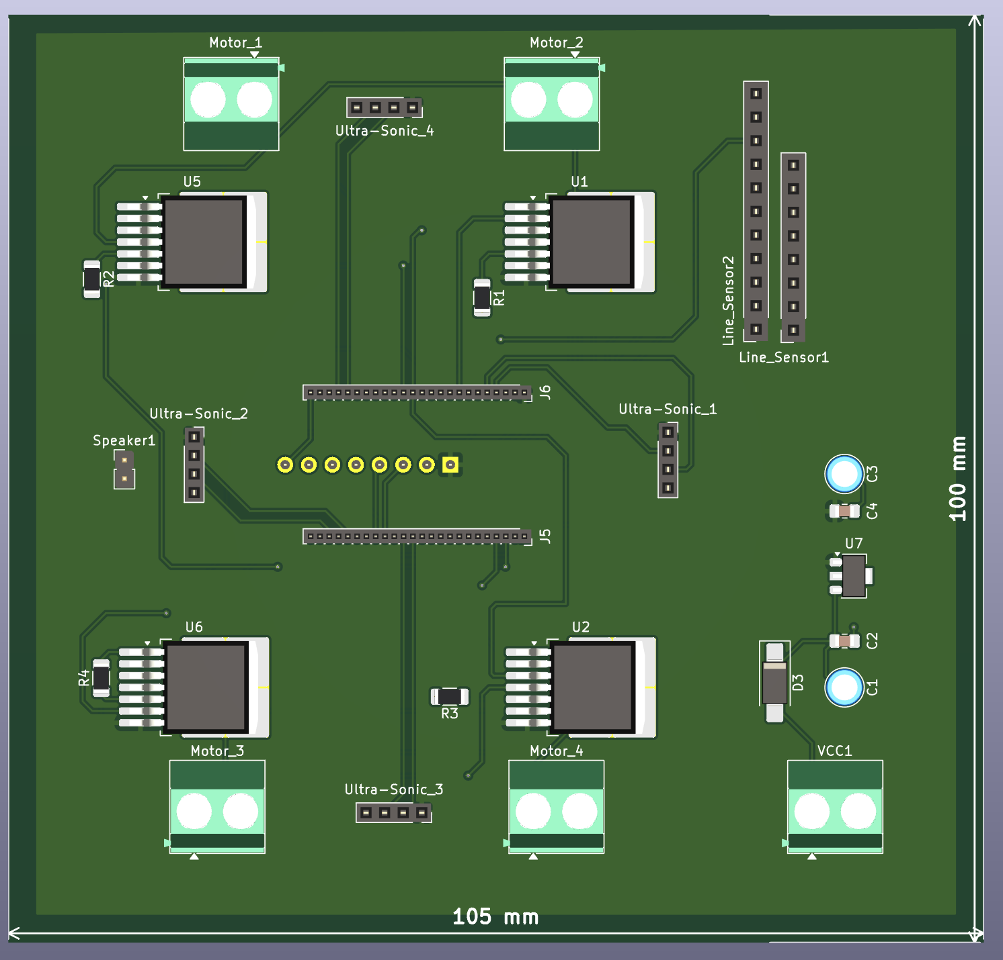
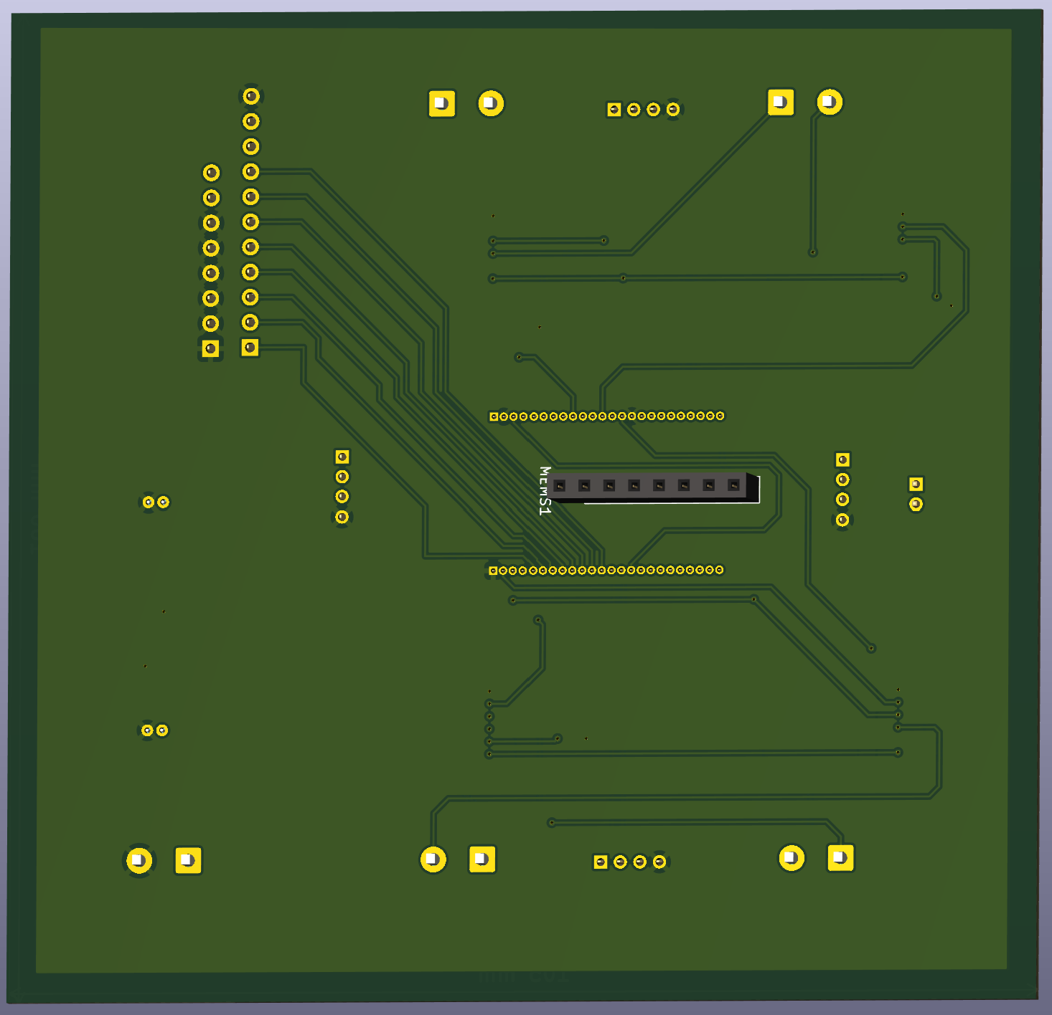
3D View: Top Layer & Bottom Layer

Slide 31
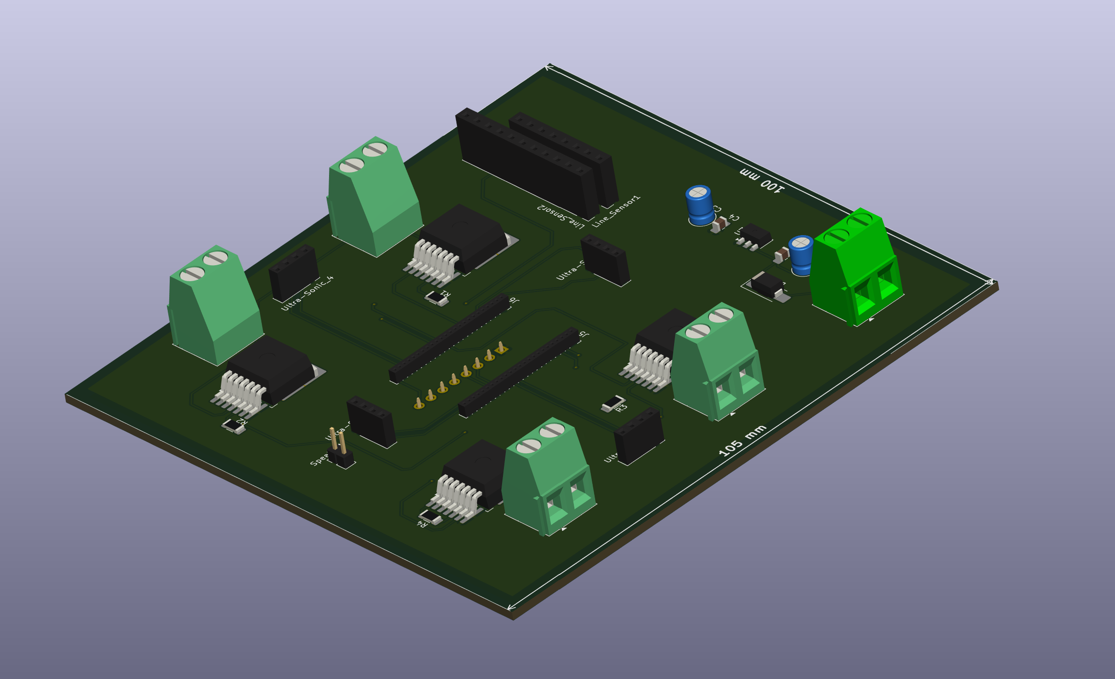
PCB Design: Component and Layer Reference

Slide 32
Conclusion:
This project showcases a complete system design cycle from documentation through CAD and PCB development. Team members worked independently and collaboratively to ensure all subsystems fit together without exceeding budget, space, or runtime constraints. The final robot, once fabricated, is expected to navigate complex environments, track lines, avoid obstacles, and give user feedback acoustically all within the constraints defined in Requirement Set 5

Slide 33
Future improvements:
What could be optimized in a future version?
In what ways can we improve our design
How scalable is our design for future tasks or competions?

Slide 34
Thank you!

